Slide 1

Azure Synapse Analytics Technical Boot Camp Day 1
Notes:
Welcome to the first day of the Azure Synapse Analytics technical boot camp.
This training provides practical guidance on the design, implementation, and operation of an Azure Synapse Analytics solution.
Let’s take a moment now and introduce the team ….. {introduce yourself and your colleagues}
Okay let’s get started!

Slide 2
A look into Day 1
Kick-Off | 8:00-8:05 | Welcome | Main Call
 | 8:05-8:30 | Azure Synapse Analytics 101
 | 8:30-8:45 | Demo Walkthrough
Ingest | 8:45-9:00 | Break
 | 9:00-10:00 | Data Loading & Data Lake Organization
 | 10:00-11:00 | Activity: Data Lake Design & Security Considerations | Table Group Call
 | 11:00-11:15 | Break
 | 11:15-12:00 | Build Hands-on: Data Integration Part 1 | Table Group Call
Transform | 12:00-1:00 | Break | Main Call
 | 1:00-1:30 | Data Transformations
 | 1:30-2:00 | Activity: Data Engineering Discussion
 | 2:00-3:00 | Build Hands-on: Data Integration Part 2 | Table Group Call
 |  | End of Day 1
Today we will be learning and collaborating across three spaces:
Main call (this meeting)
Table Group channel within the event Team
CloudLabs Learner Portal & Synapse environment
Presentation/
Whole Group
Lab
Activity/ Discussion/ Group Work
Announcements
Notes:
This training takes place across three spaces
The main call, where we are now, as well as small group channels for collaborative activities.
Hands on labs are also provided during this training, it is recommended that you remain in your table group calls when working on labs in case you have questions or run into difficulties.

Slide 3
A look into Day 1
Kick-Off | 6:30-6:35 | Welcome | Main Call
 | 6:35-7:00 | Azure Synapse Analytics 101
 | 7:00-7:15 | Demo Walkthrough
Ingest | 7:15-7:30 | Break
 | 7:30-8:30 | Data Loading & Data Lake Organization
 | 8:30-9:30 | Activity: Data Lake Design & Security Considerations | Table Group Call
 | 9:30-9:45 | Break
 | 9:45-10:30 | Build Hands-on: Data Integration Part 1 | Table Group Call
Transform | 10:30-11:30 | Break | Main Call
 | 11:30-12:00 | Data Transformations
 | 12:00-12:30 | Activity: Data Engineering Discussion
 | 12:30-1:30 | Build Hands-on: Data Integration Part 2 | Table Group Call
 |  | End of Day 1
Today we will be learning and collaborating across three spaces:
Main call (this meeting)
Table Group channel within the event Team
CloudLabs Learner Portal & Synapse environment
Presentation/
Whole Group
Lab
Activity/ Discussion/ Group Work
Announcements
Notes:
This training takes place across three spaces
The main call, where we are now, as well as small group channels for collaborative activities.
Hands on labs are also provided during this training, it is recommended that you remain in your table group calls when working on labs in case you have questions or run into difficulties.

Slide 4
Azure Synapse Analytics 101 Limitless analytics service with unmatched time to insight

Slide 5

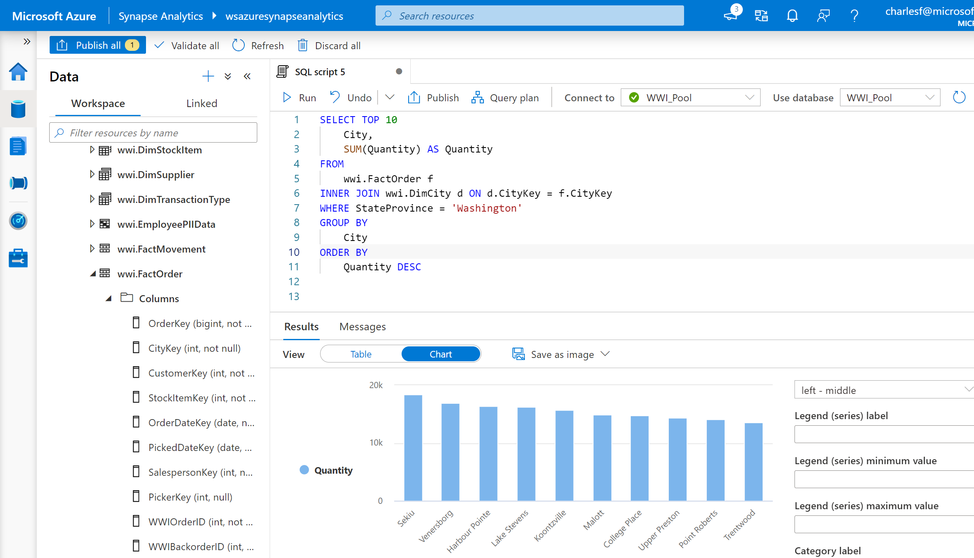
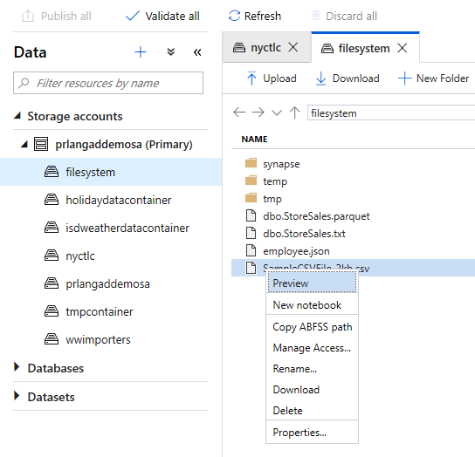
Synapse Studio
Unified workspace
A single place for Data Engineers, Data Scientists, and IT Pros to collaborate on enterprise analytics
Notes:
Azure Synapse studio provides a unified workspace for your data prep, data management, data warehousing, big data, and AI tasks. The highly visual, code-free interface works for everyone. Here, data engineers can manage data pipelines, database administrators can automate query optimization, and data scientists can build proofs of concept in minutes.
Synapse Studio is the web-native experience that ties everything together in one location so you can do every task you need to build a complete solution.

Slide 6
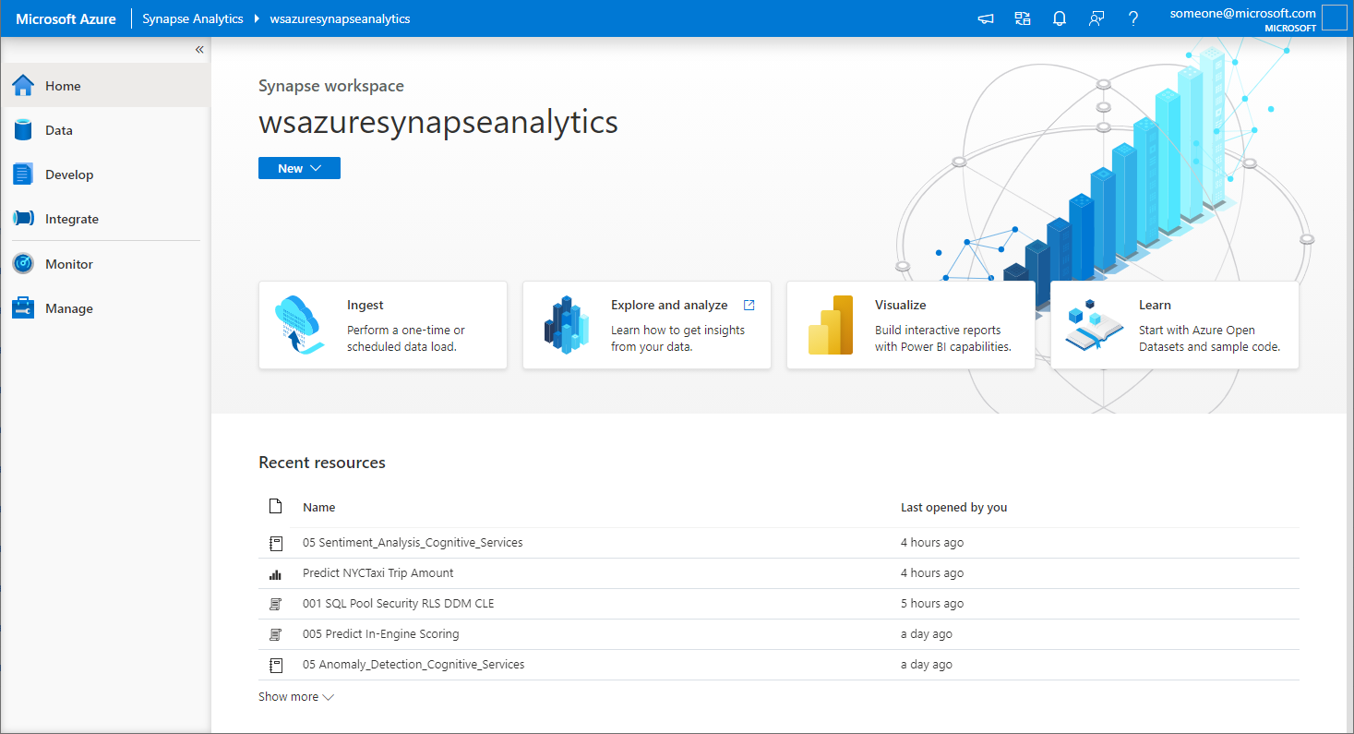






Synapse Studio
Synapse Studio divided into Activity hubs.
These organize the tasks needed for building analytics solution.
Home
Data
Develop
Integrate
Quick-access to common gestures, most-recently used items, and links to tutorials and documentation.
Explore structured and unstructured data
Write code and the define business logic of the pipeline via notebooks, SQL scripts, Data flows, etc.
Design pipelines that that move and transform data.
Monitor
Manage
Centralized view of all resource usage and activities in the workspace.
Configure the workspace, pool, linked service, access to artifacts
Notes:
We will be covering each of these hubs in this introduction in more detail

Slide 7
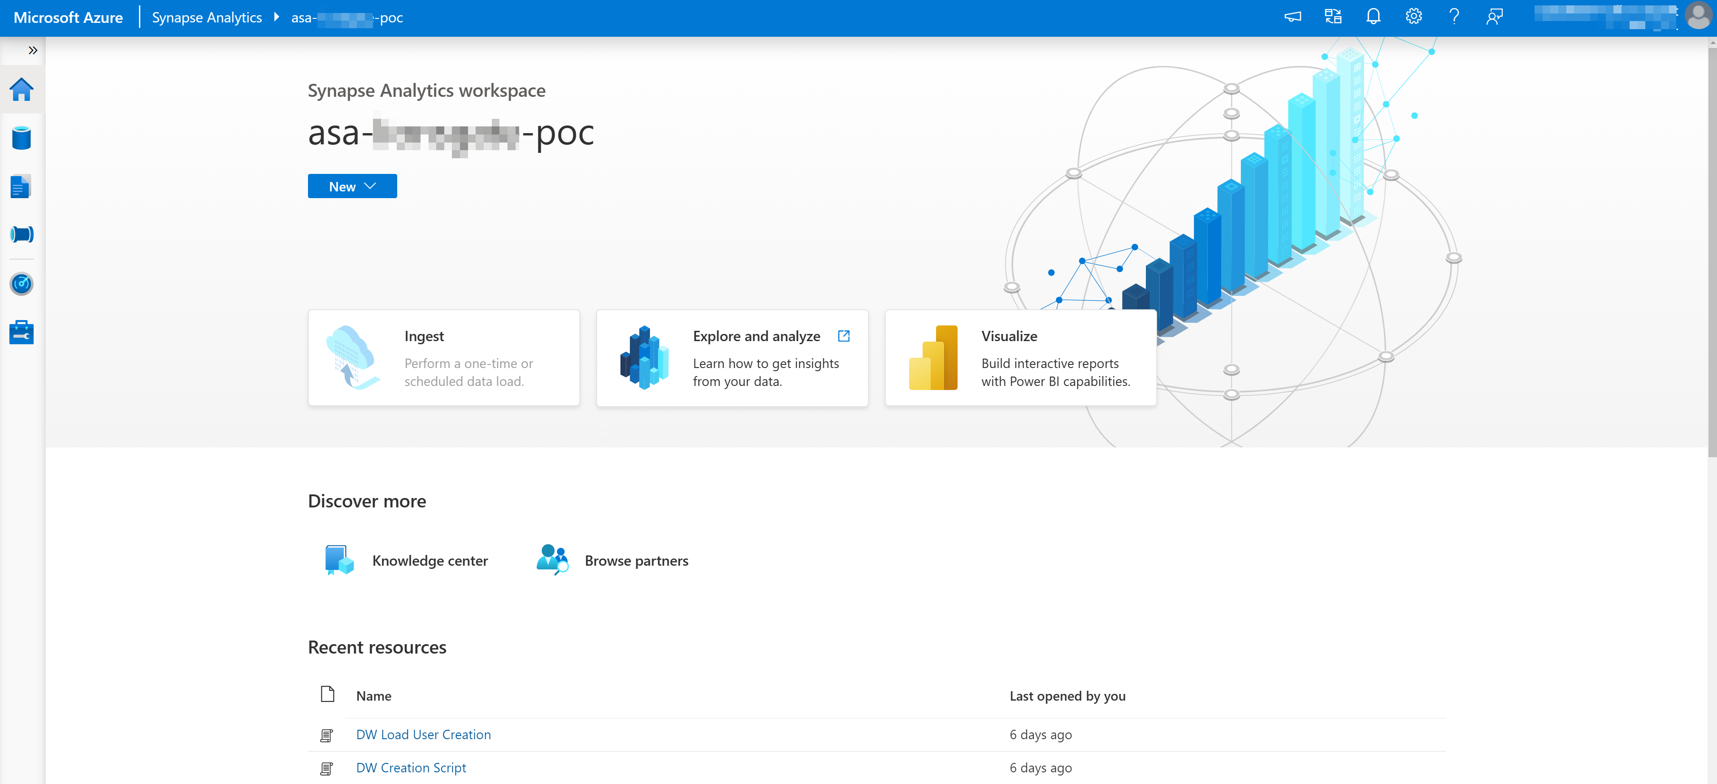
Home hub
Ease of access to get updates, to switch workspace, to get notifications and to provide feedback
Updates
Switch Workspaces
Language
Settings
Help
Knowledge Center
Feedback
Integrate
Notes:
Ingest allows for quick access to a copy data tool to move data from one location to another
Explore and analyze – tutorial in how to get started querying data
Visualize – shows quick access to reports in linked Power BI workspaces
Learn - Knowledge Center

Slide 8
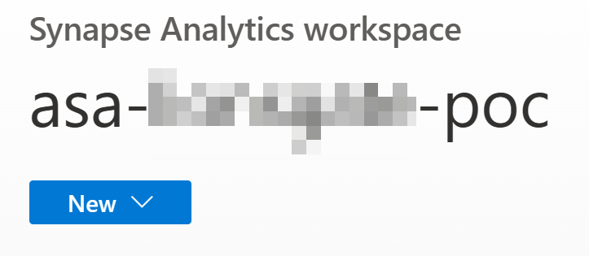
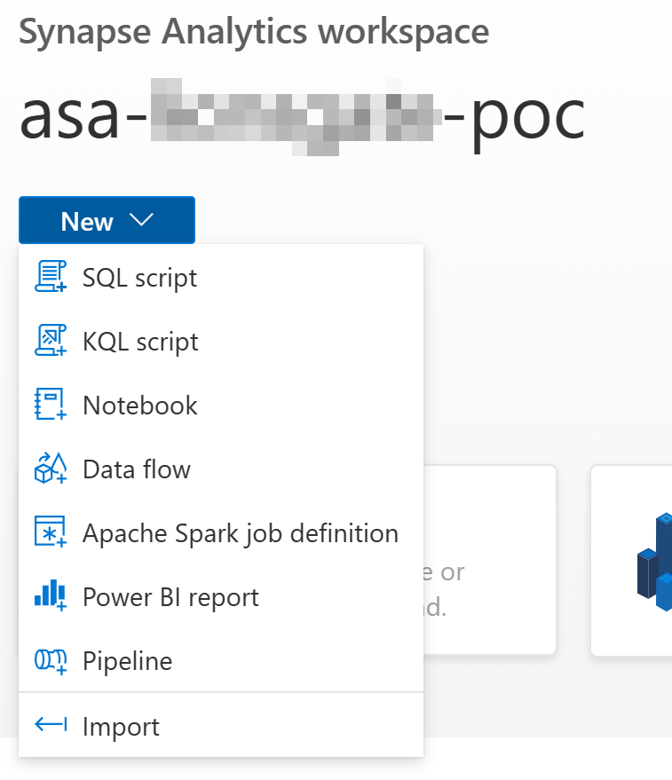
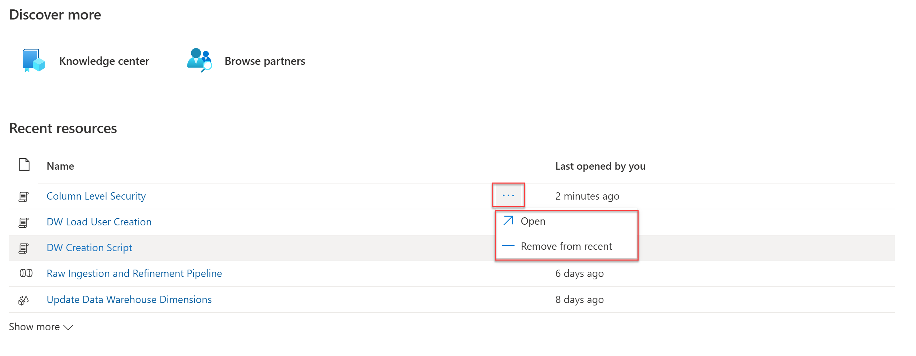
Home hub
Overview
New dropdown – offers quickly start work item
Recent resources – Lists recently opened workspace artifacts for quick access

Slide 9
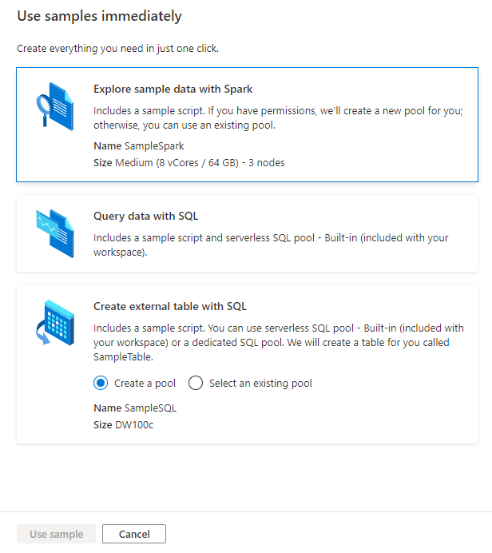
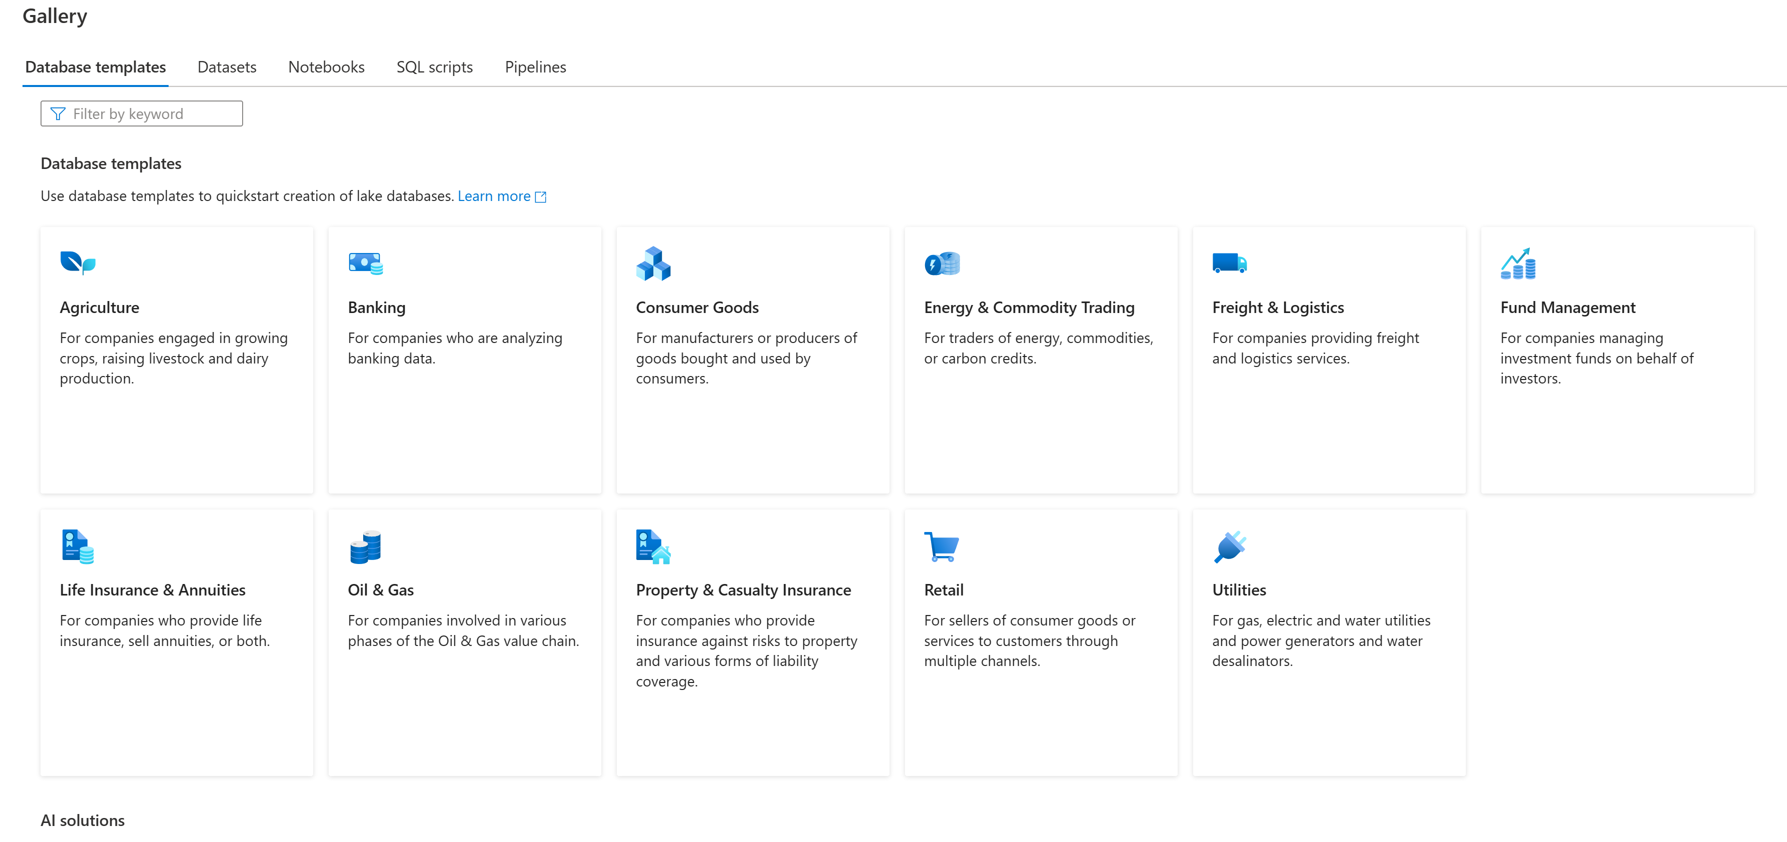
Knowledge center
Knowledge center offers industry-specific database templates, open datasets, sample notebooks, SQL scripts and pipeline templates for easy start and learning

Slide 10
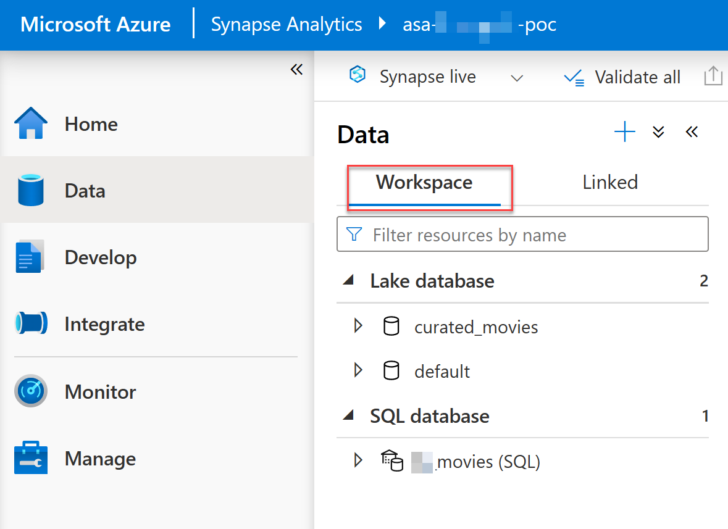
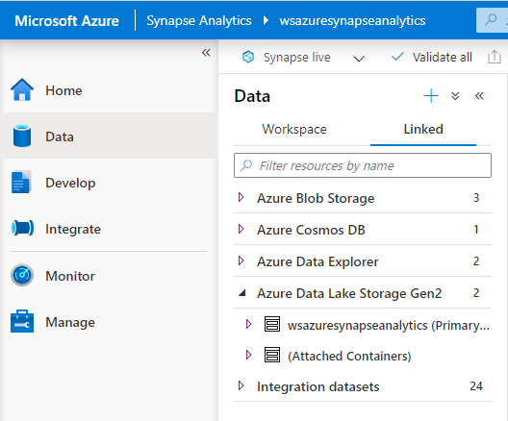
Data hub
Explore data inside the workspace and in linked storage accounts
Notes:
Workspace == Databases
Linked == Storage accounts

Slide 11
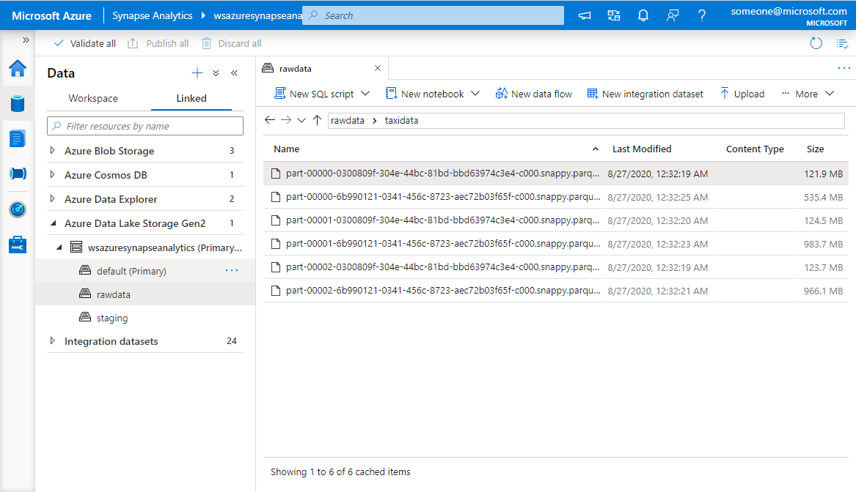
Data hub - Linked
Browse Azure Data Lake Storage Gen2 accounts – filesystems, Azure Data Explorer – clusters, Azure Cosmos DB -containers
Linked Cosmos DB Analytical Store
File path
Linked Azure Data Explorer
Linked ADLS Gen2 Account
Container (filesystem)

Slide 12
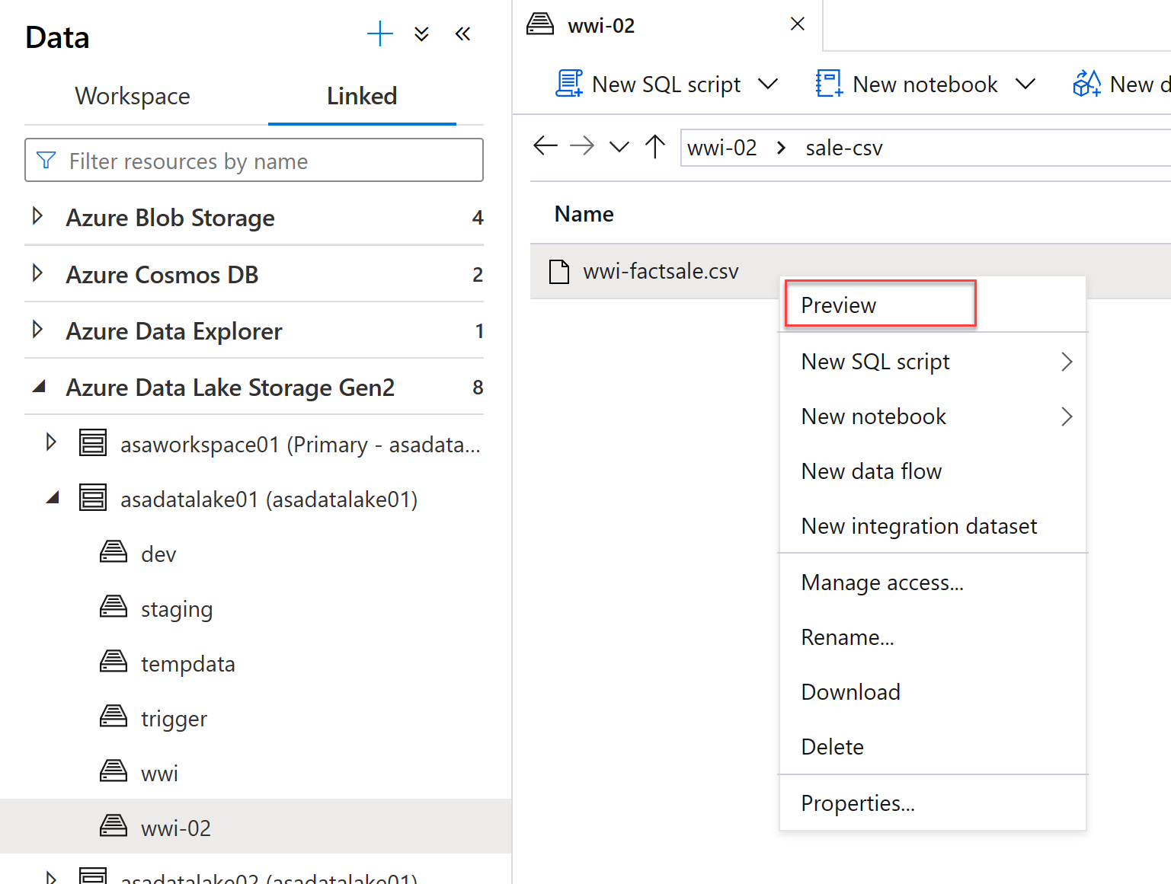
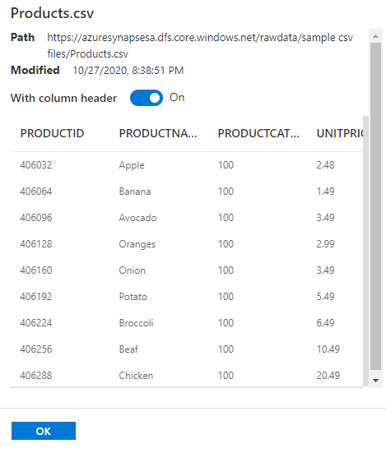
Data hub – Storage accounts
Preview a sample of your data

Slide 13
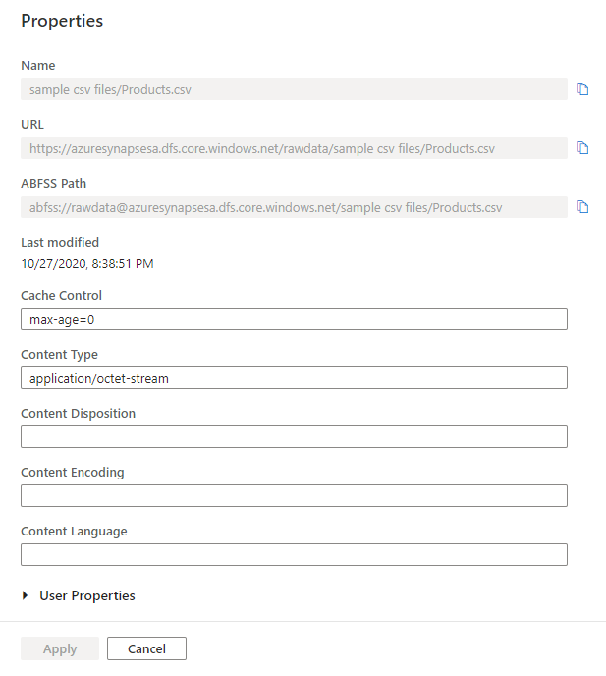
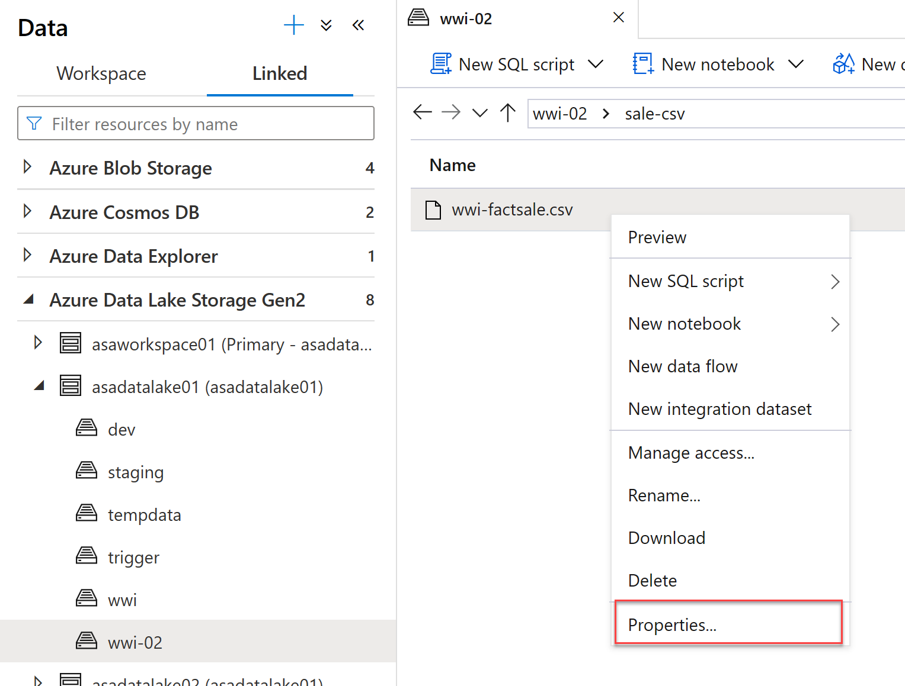
Data hub – storage accounts
See basic file properties

Slide 14
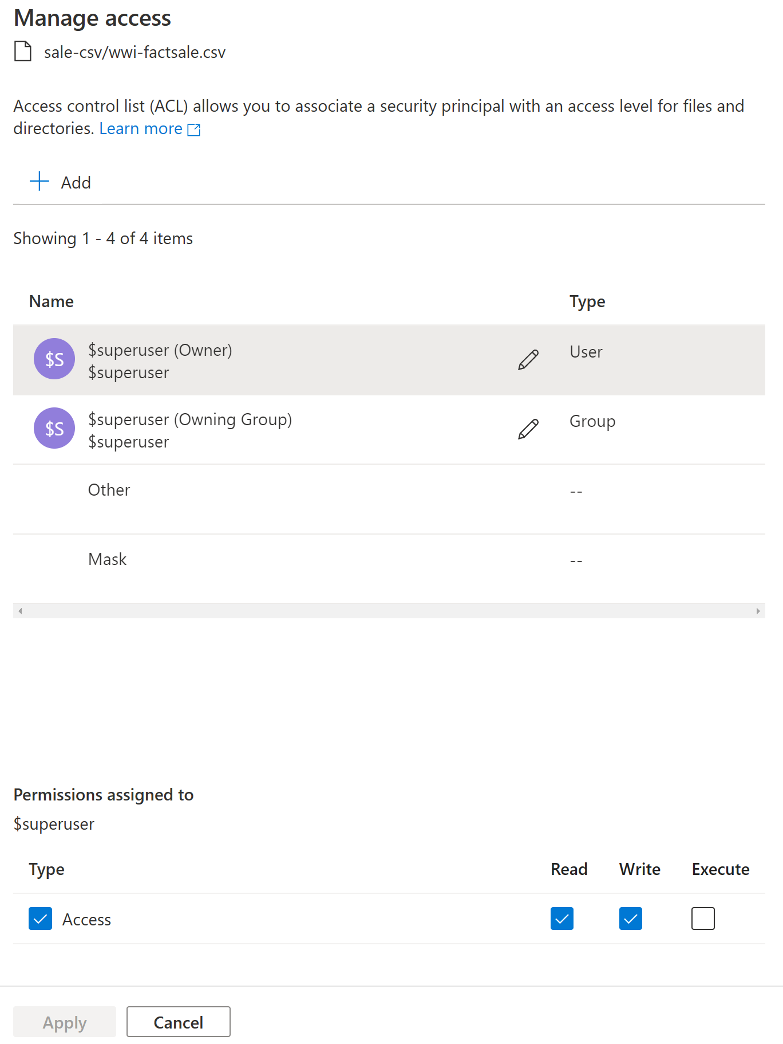
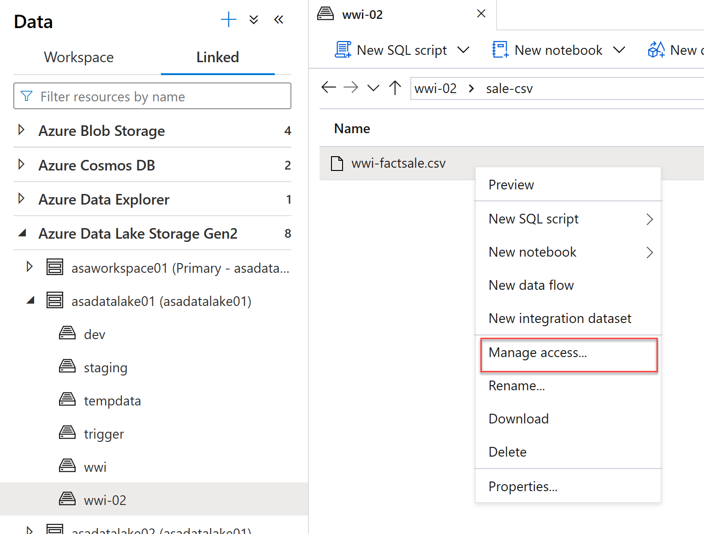
Data hub – storage accounts
Manage Access - Configure standard POSIX ACLs on files and folders

Slide 15
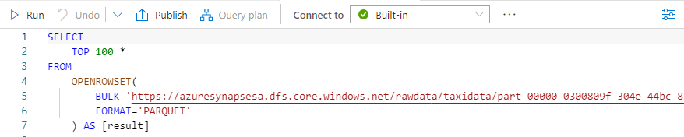
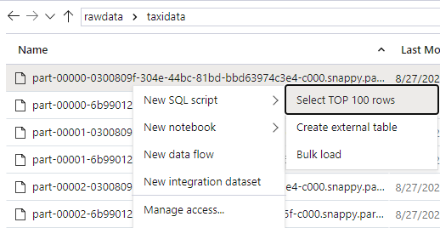
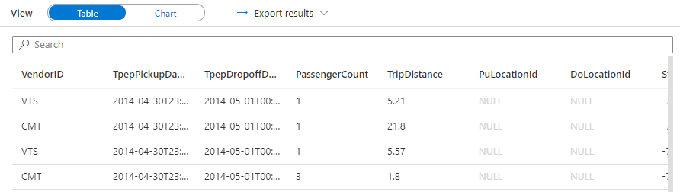
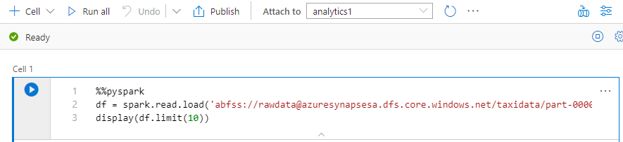
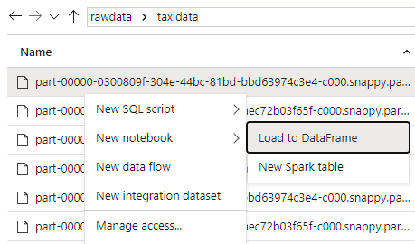
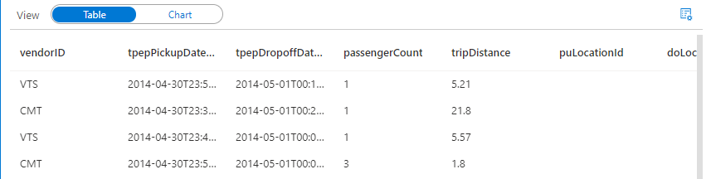
Data hub – storage accounts
Two simple gestures to start analyzing with SQL scripts or with notebooks.
T-SQL or PySpark auto-generated.

Slide 16
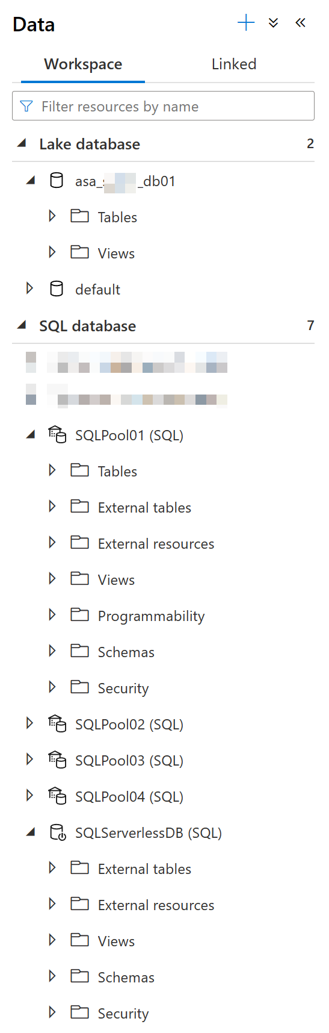
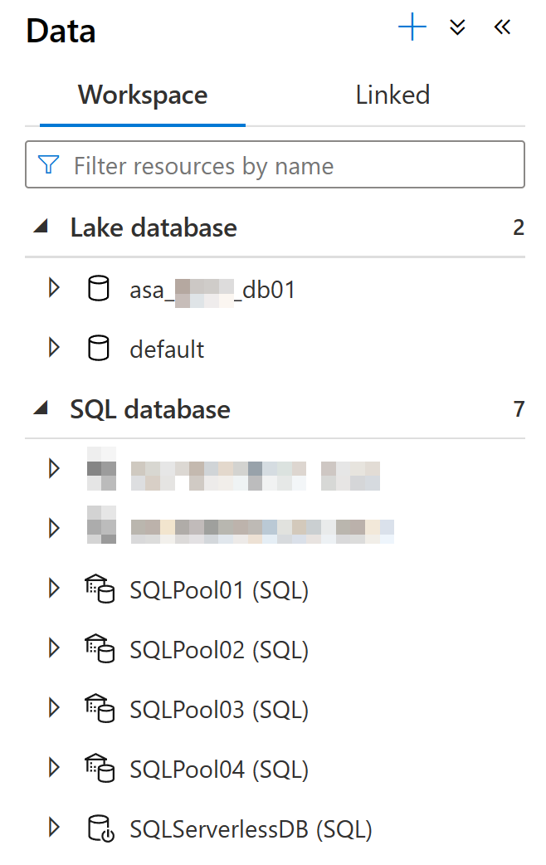
Data hub – databases
Explore the different kinds of databases that exist in a workspace.
Lake database
Dedicated SQL pool
Serverless SQL pool

Slide 17
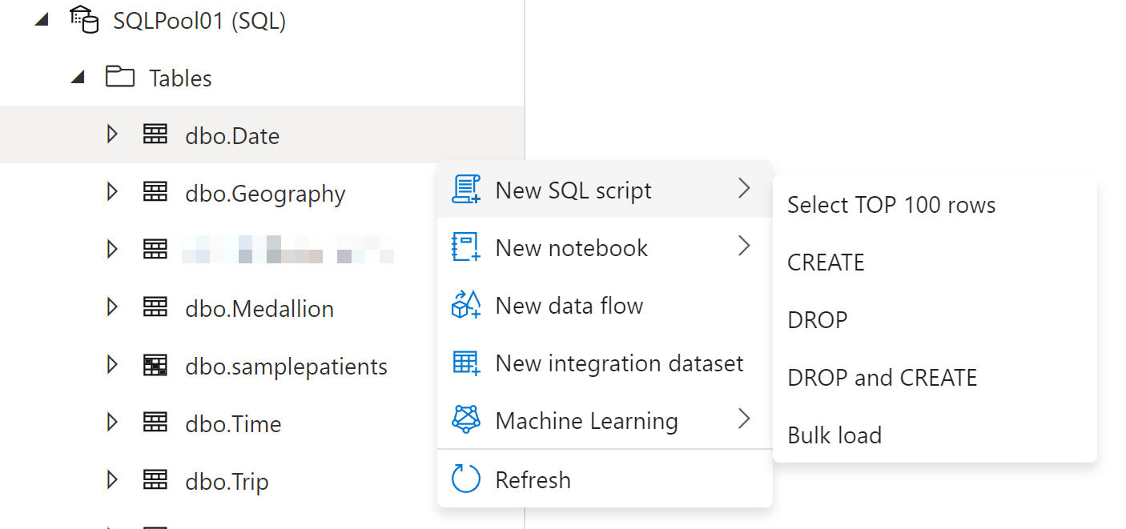
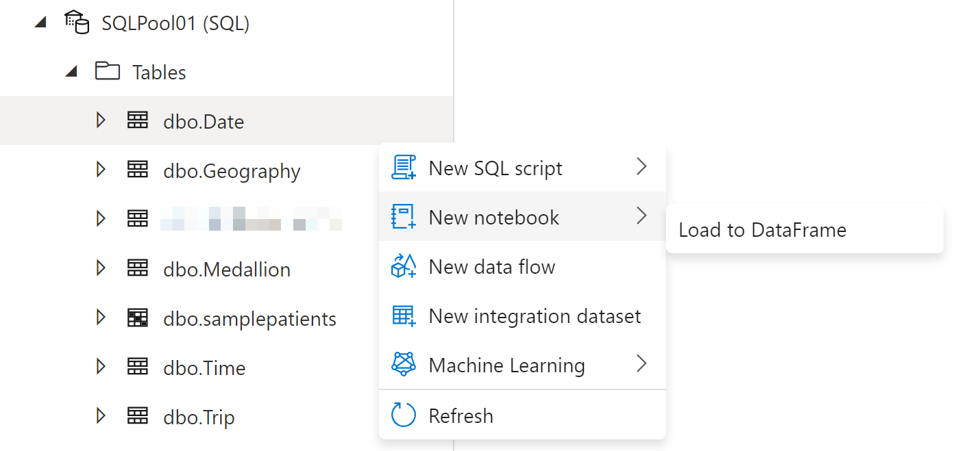
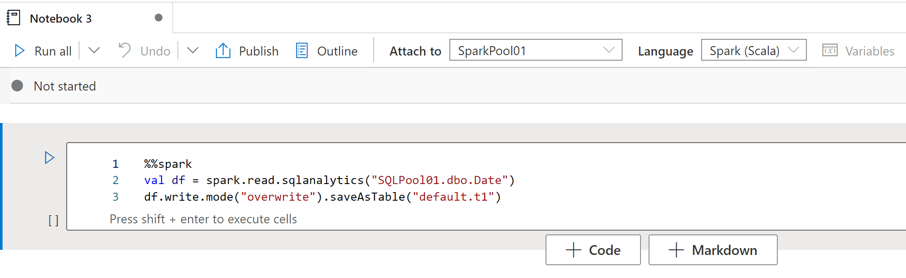
Data hub – databases
Familiar gesture to generate T-SQL scripts from SQL metadata objects such as tables.
Starting from a table, auto-generate a single line of PySpark code that makes it easy to load a SQL table into a Spark dataframe​

Slide 18
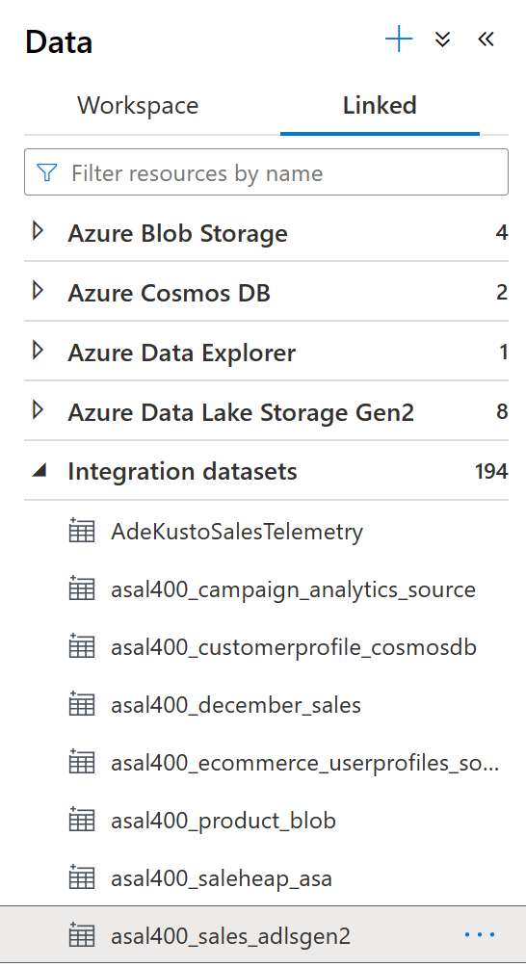
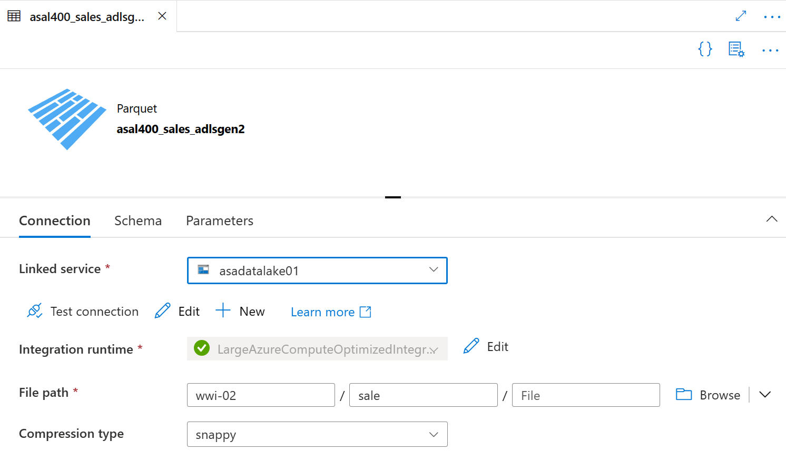
Data hub – datasets
Integration datasets describe data that is persisted. Once a dataset is defined, it can be used in pipelines and sources of data or as sinks of data.

Slide 19
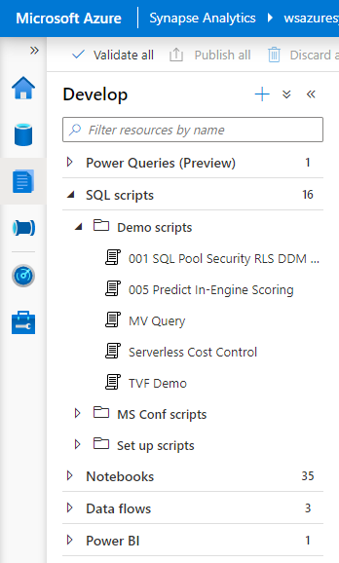
Develop hub
Overview
It provides development experience to query, analyze, model data
Benefits
Multiple languages to analyze data under one umbrella
Switch over notebooks and scripts without loosing content
Code intellisense offers reliable code development
Create insightful visualizations
Organize artifacts in folders and sub-folders

Slide 20
Develop hub – SQL scripts
SQL Editor
Automatic code completion (Intellisense)
Script collaboration within the Workspace
Built-in visualizations
Easily switch between clusters

Slide 21
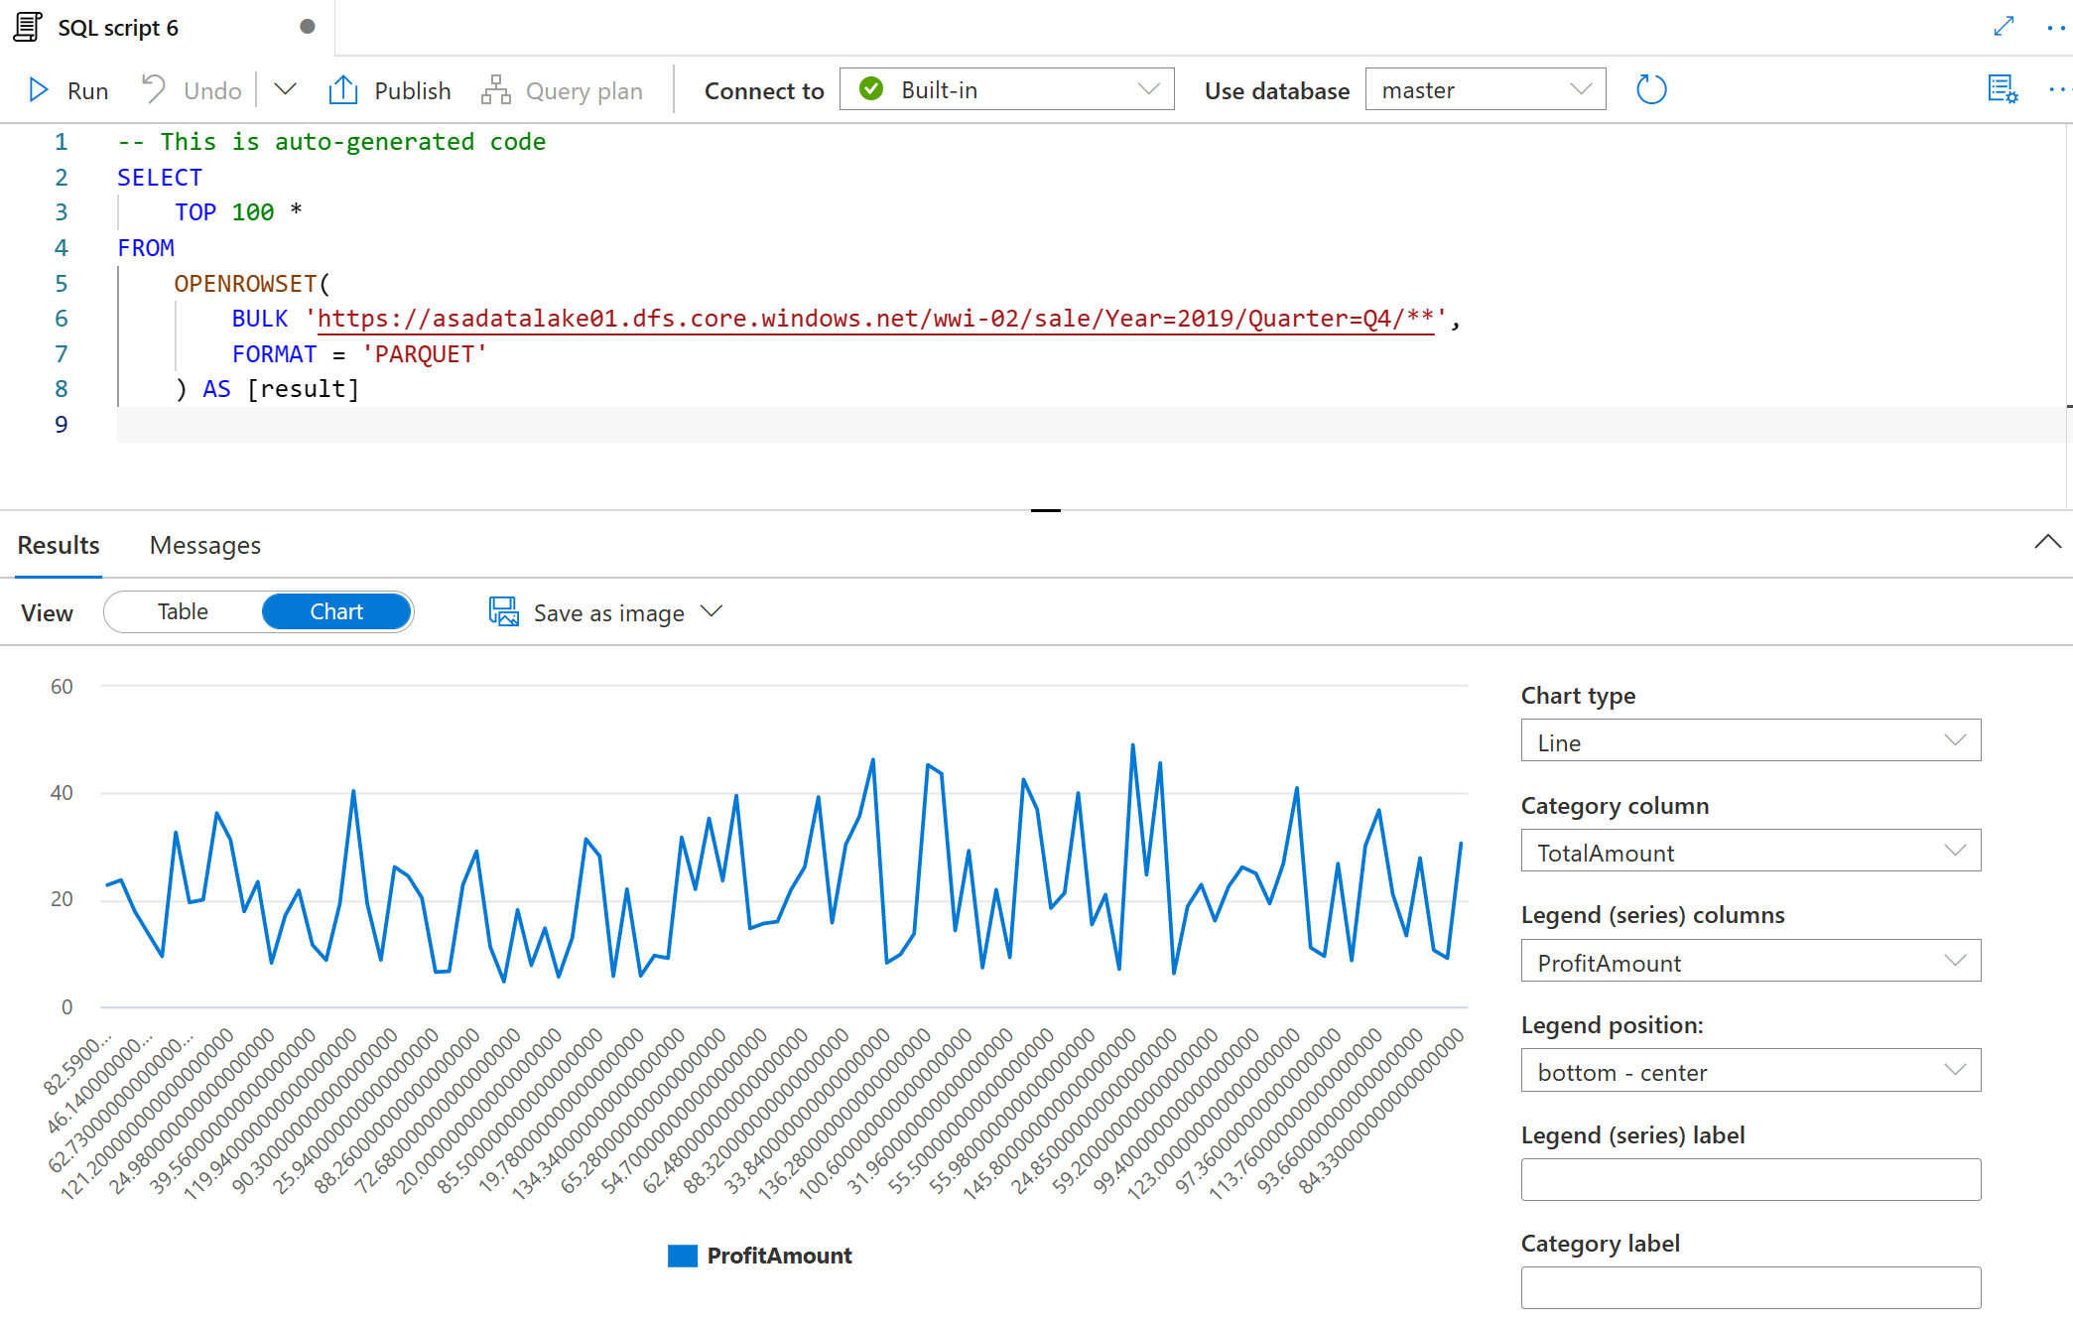
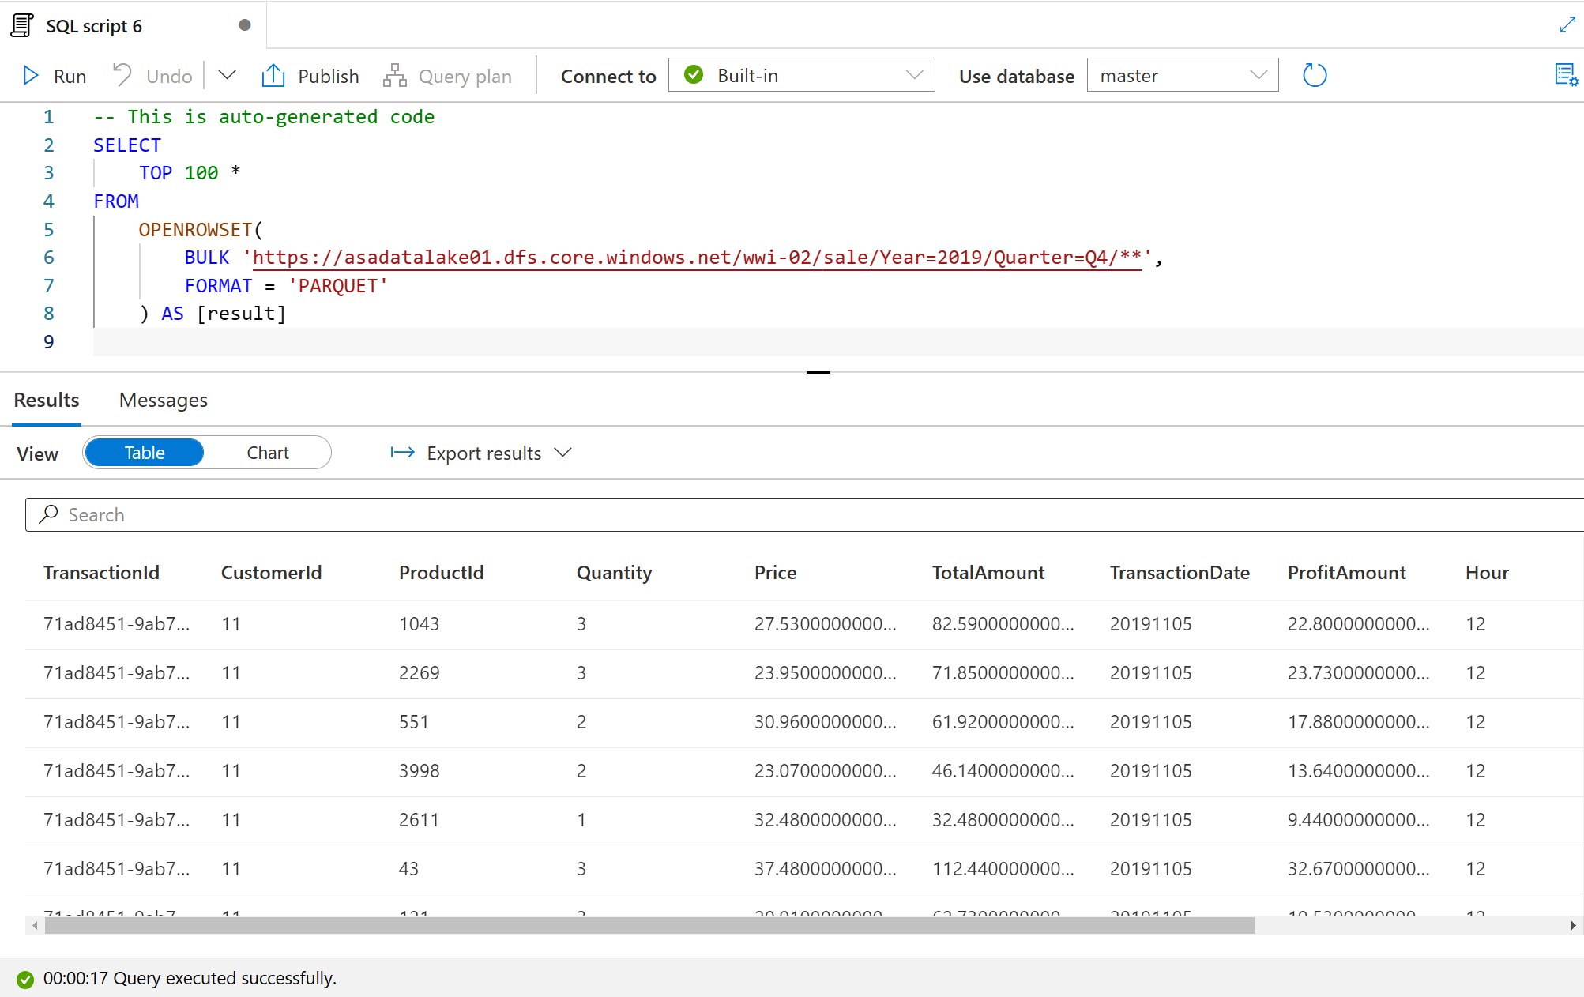
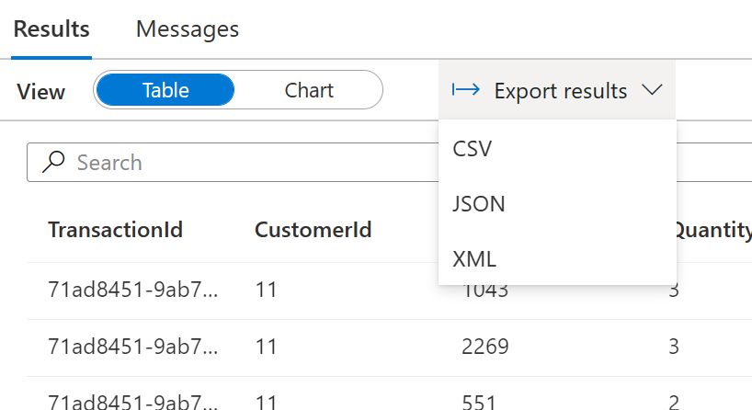
Develop hub – SQL scripts
SQL Script
View results in Table or Chart form and export results in several popular formats

Slide 22
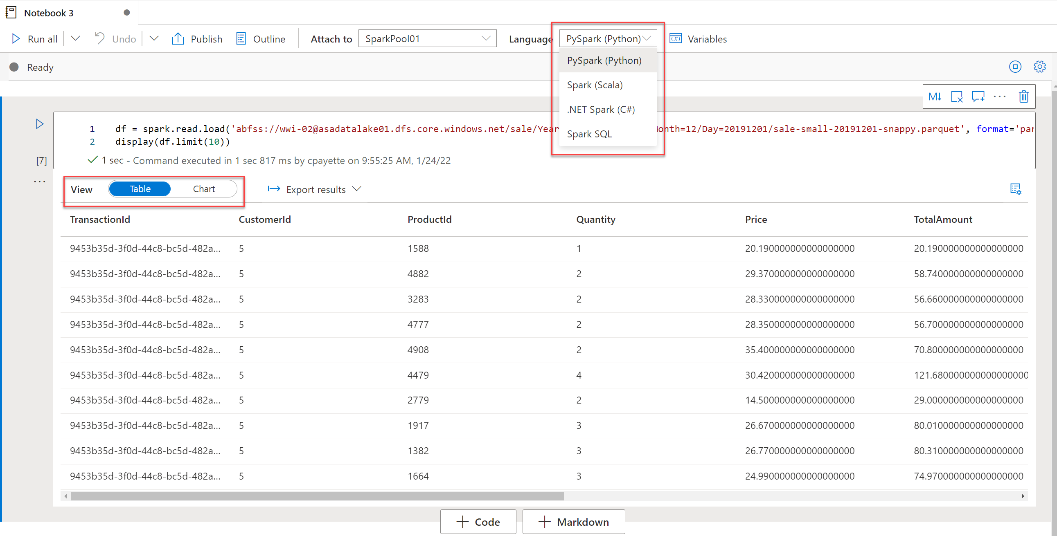
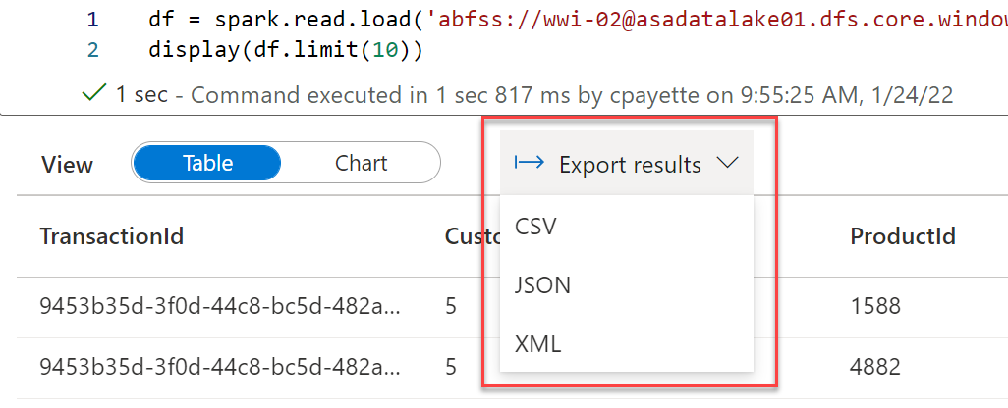
Develop hub – Notebooks
The notebook experience supports PySpark, Spark, .NET Spark and SQL languages.
Output displays below the code cell with options to view data in tabular or chart format.
Multiple data export options are also available.

Slide 23
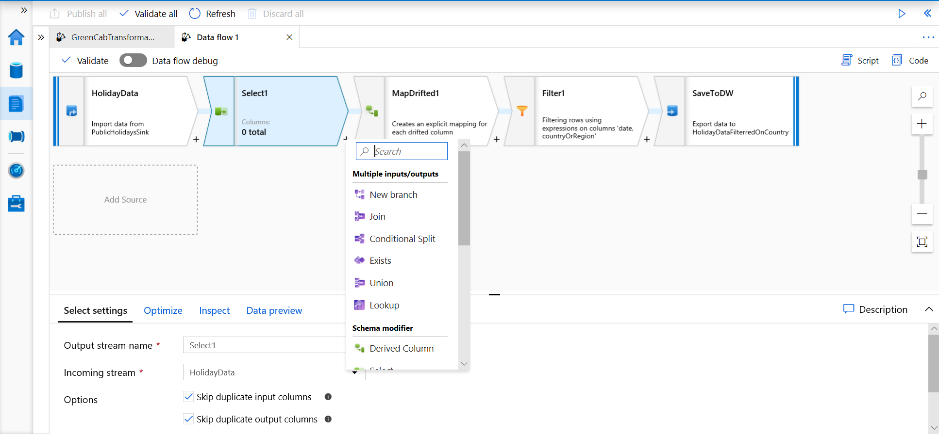
Develop hub – Data flows
Data flows are a visual way of specifying how to transform data.
Provides a code-free experience.

Slide 24
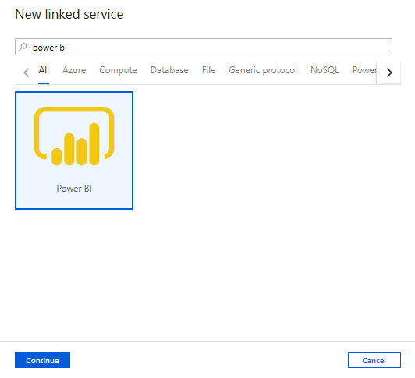
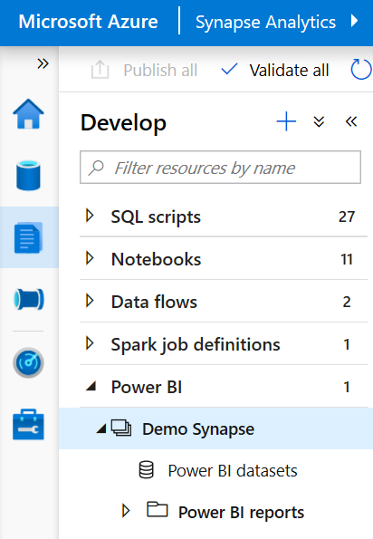
Develop hub – Power BI
Overview
Create Power BI reports in the workspace
Provides access to published reports in the workspace
Update reports real time from Synapse workspace to get it reflected on Power BI service
Visually explore and analyze data

Slide 25
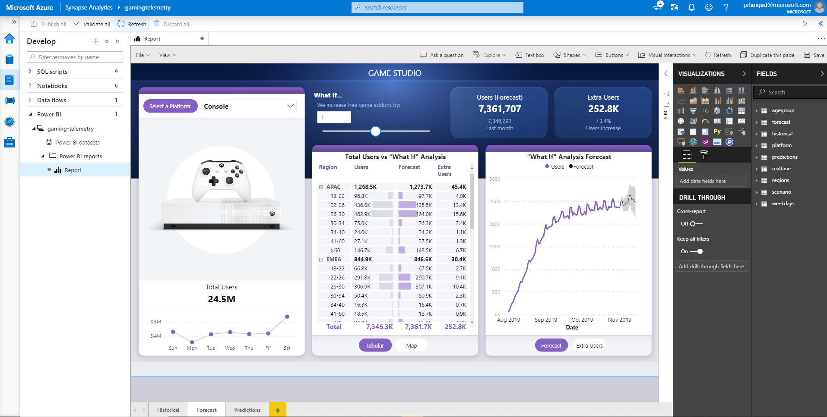
Develop hub – Power BI
View published reports in Power BI workspace

Slide 26
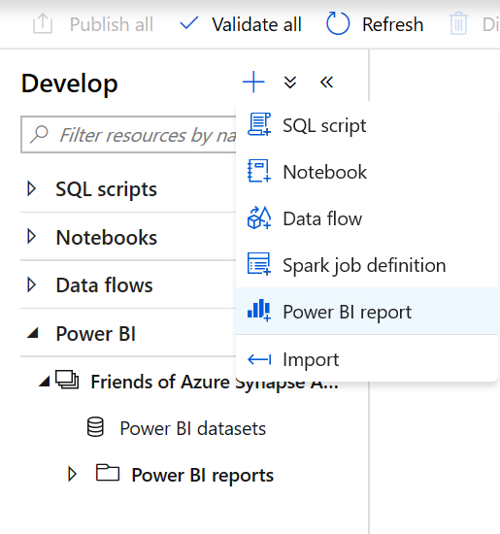
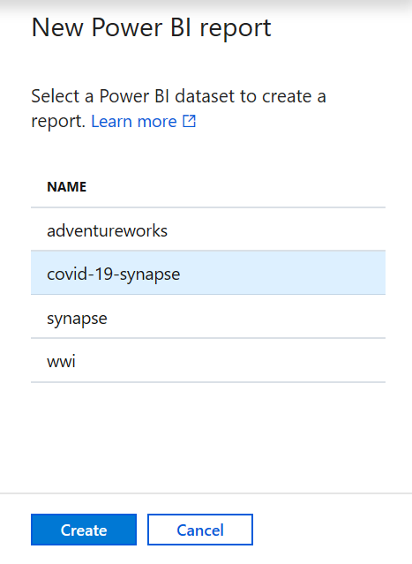
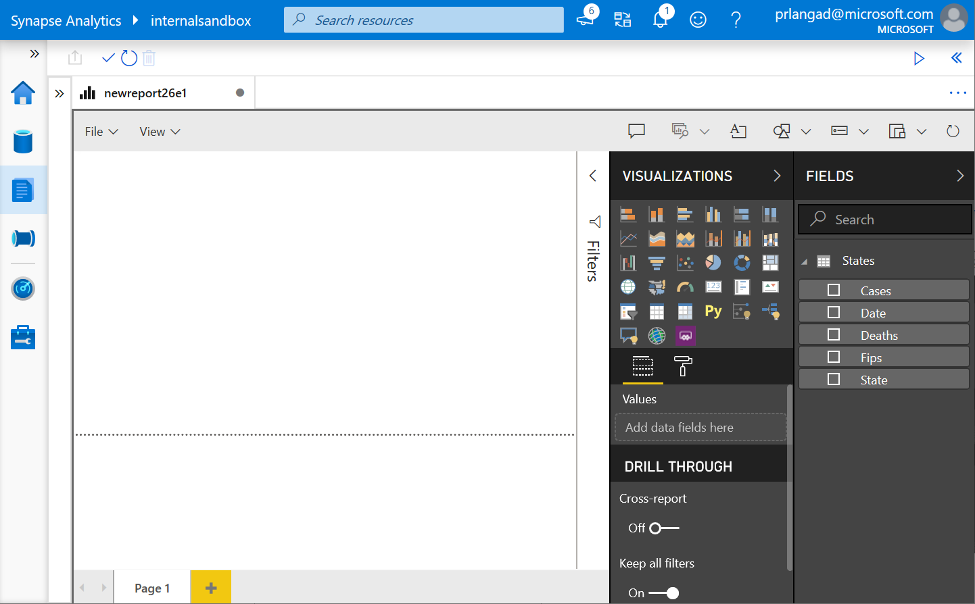
Develop Hub – Power BI
Create new reports from existing published Power BI datasets
Create new Power BI datasets
1
2
3

Slide 27
Develop hub – Power BI
Edit reports in Synapse workspace

Slide 28
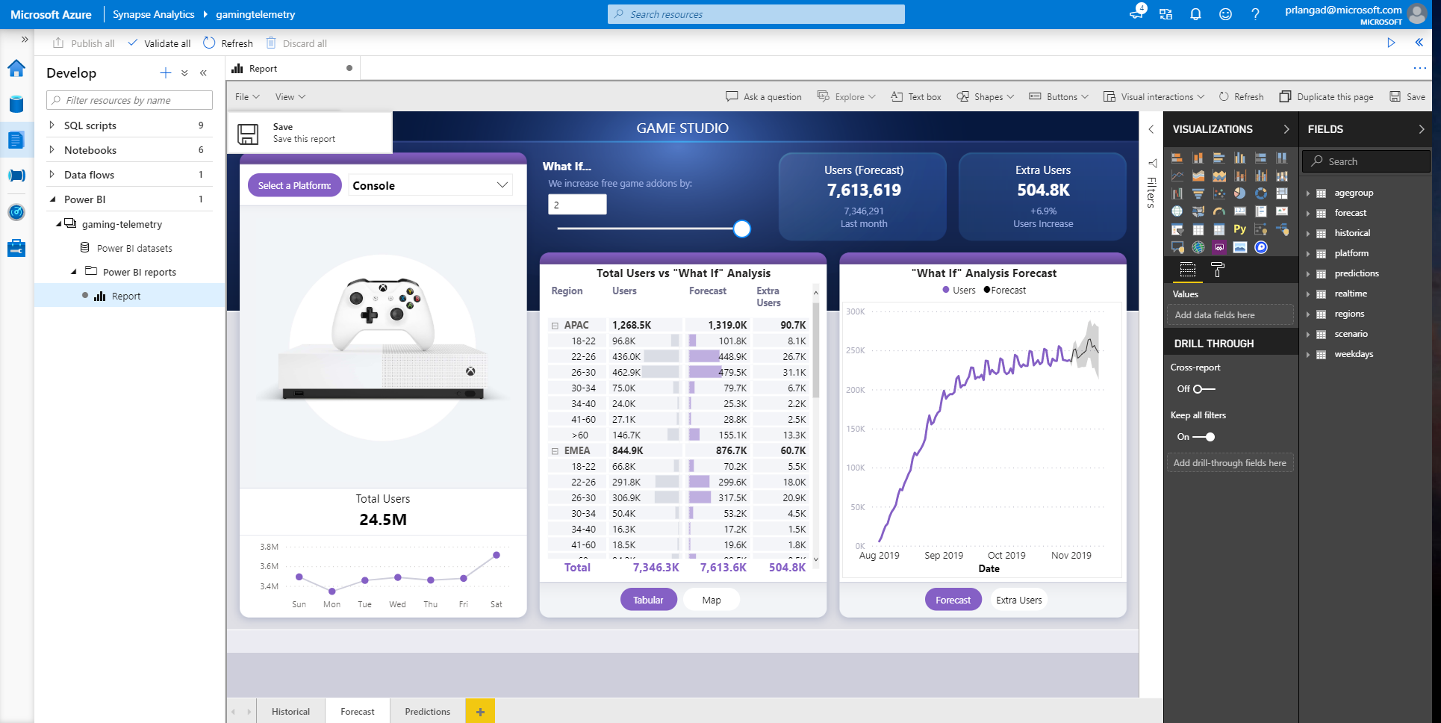
Develop hub – Power BI
Publish edited reports in Synapse workspace to Power BI workspace
Publish changes by simply saving the report in workspace

Slide 29
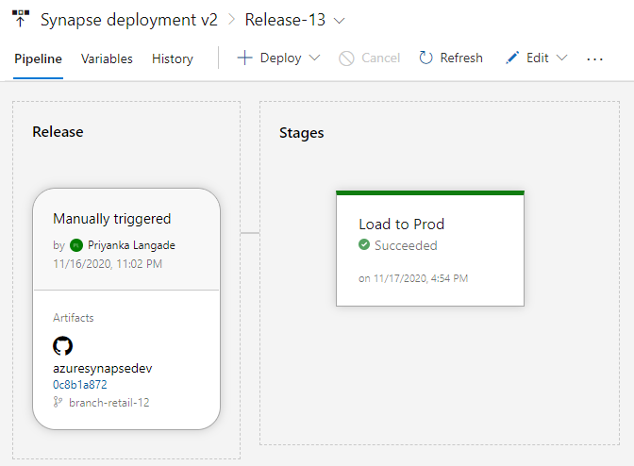
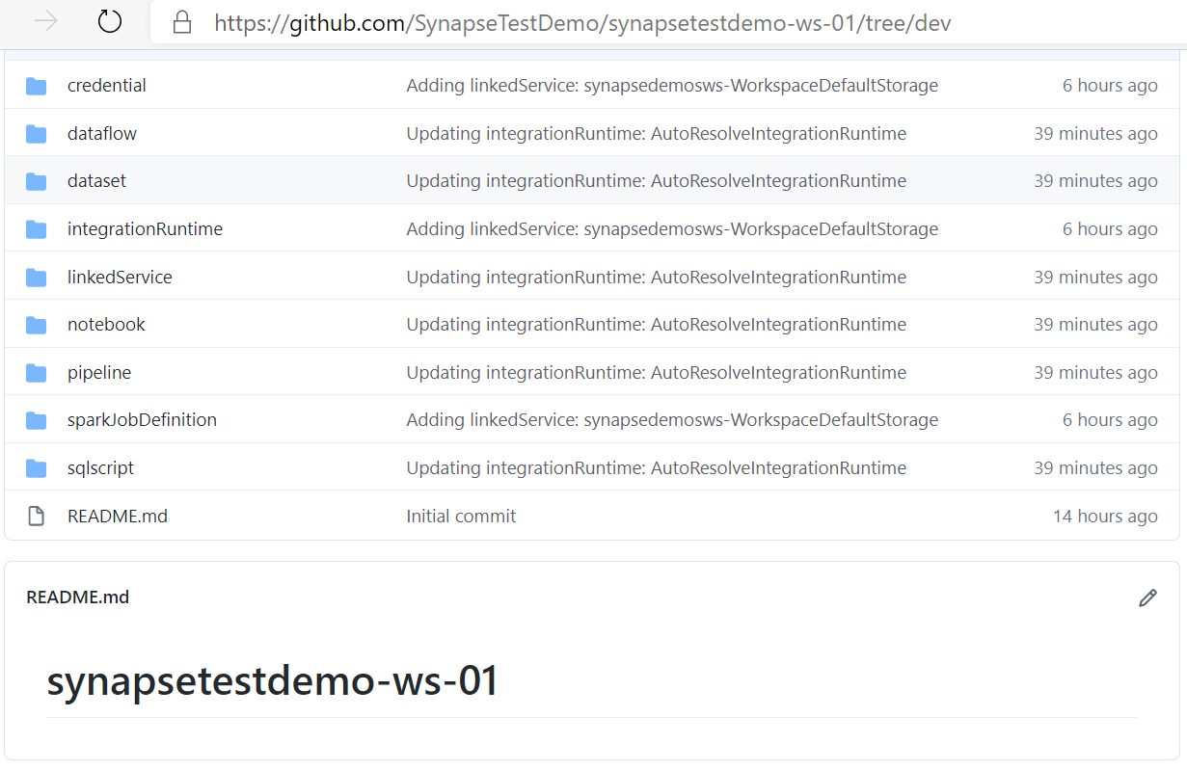
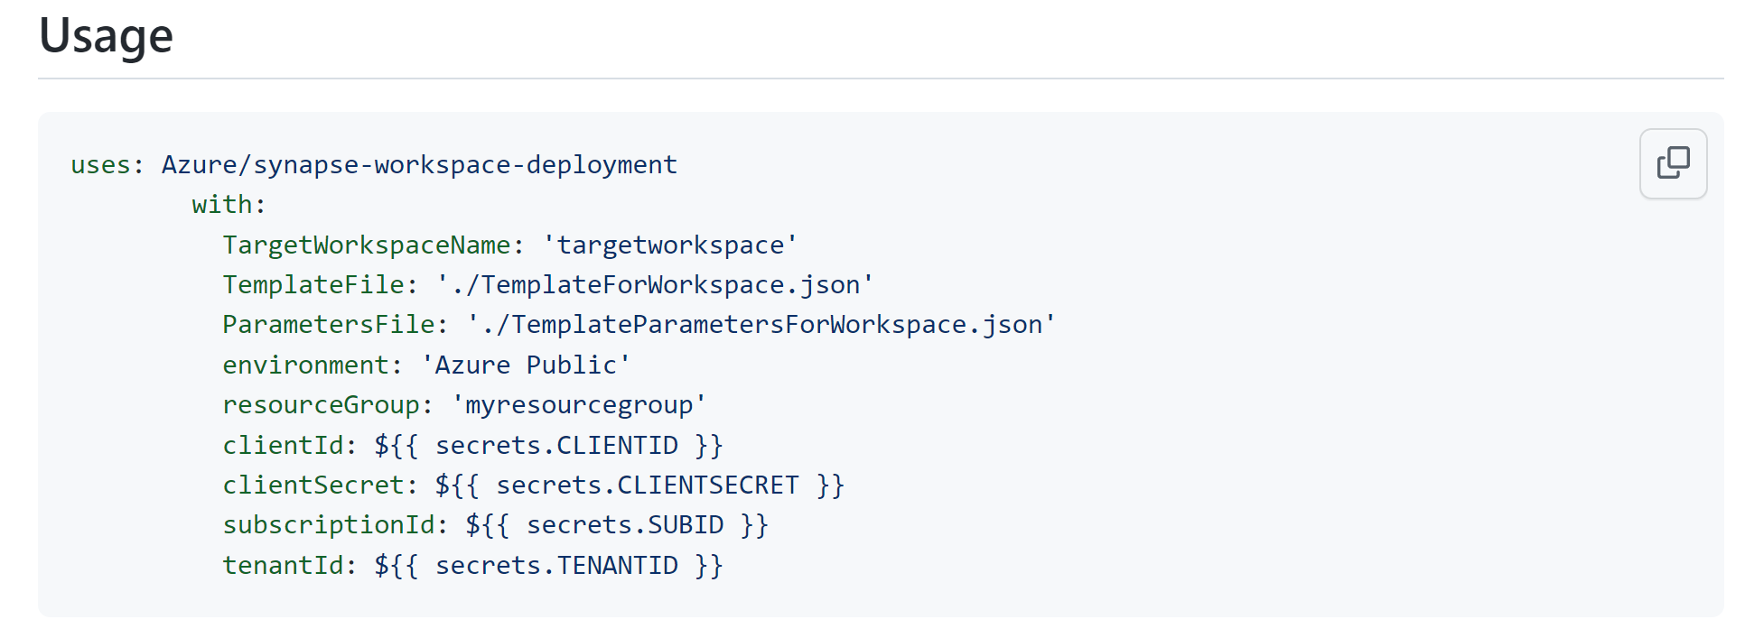

CI/CD
Commit artifacts to source-controlled repository and operationalize release pipelines with Synapse deployment task in Azure DevOps or GitHub actions
Notes:
Source control in Synapse Studio - Azure Synapse Analytics | Microsoft Docs

Slide 30
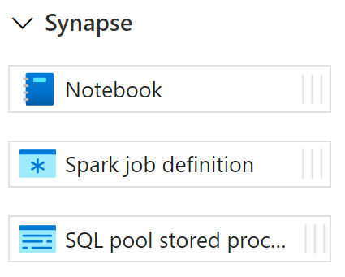
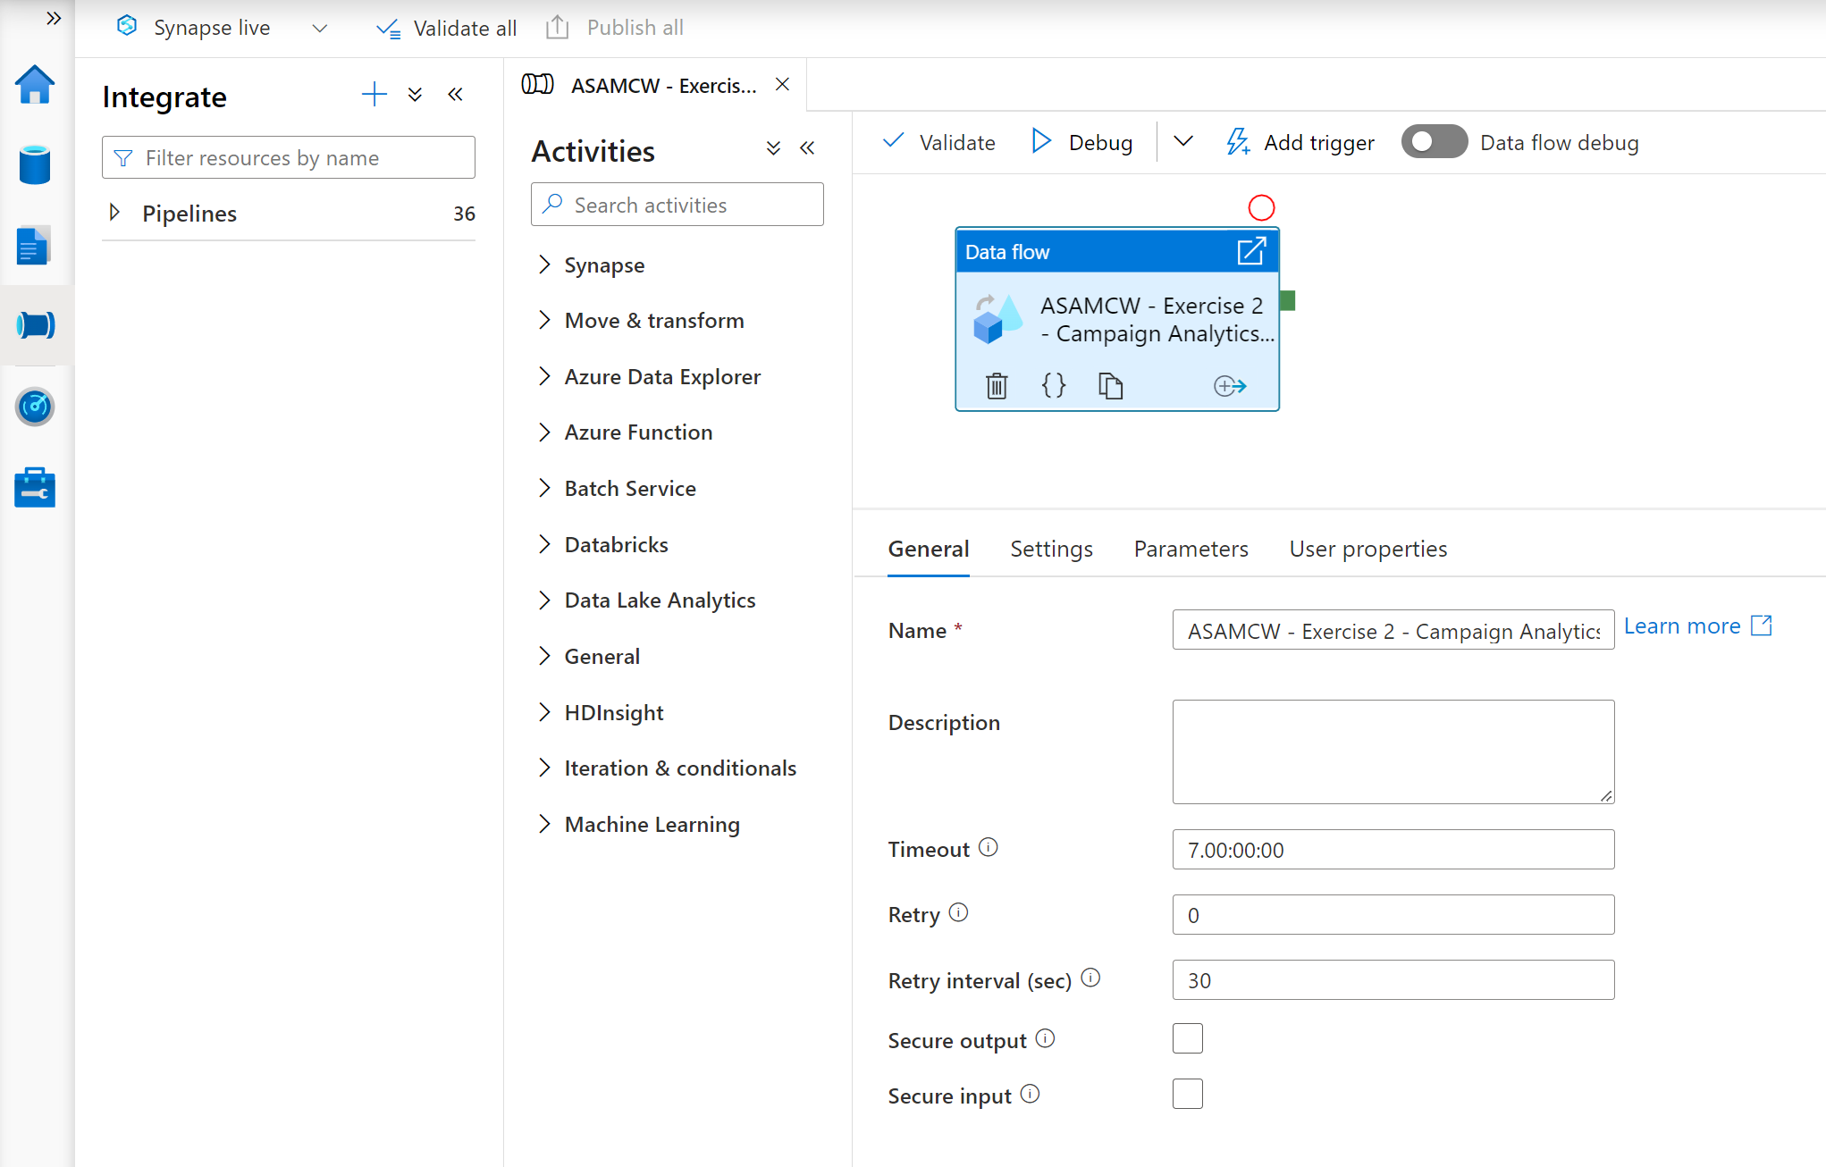


Integrate hub
Pipelines provide the ability to create pipelines to ingest, transform and load data with 100+ inbuilt connectors.
Offers a wide range of activities that a pipeline can perform.

Slide 31

Monitor hub
Overview
This feature provides single pane of glass to monitor orchestration, activities for Apache Spark Application and SQL requests.
Benefits
Offers additional filters to monitor specific activities or orchestration

Slide 32

Manage hub
Overview
This feature provides ability to manage Analytics pools, Linked Services, Integration, Security and Source Control.

Slide 33


Manage hub – Linked services
Overview
It defines the connection information needed to connect to external resources.
Benefits
Offers pre-build 90+ connectors
Easy cross platform data migration
Represents data store or compute resources

Slide 34


Manage hub – Triggers
Overview
It defines a unit of processing that determines when a pipeline execution needs to be kicked off.
Benefits
Create and manage
Schedule trigger
Tumbling window trigger
Event trigger
Control pipeline execution
Notes:
Tumbling window triggers are a type of trigger that fires at a periodic time interval from a specified start time, while retaining state. Tumbling windows are a series of fixed-sized, non-overlapping, and contiguous time intervals.

Slide 35



Manage hub – Access control
Overview
It provides access control management to workspace resources and artifacts for admins
Benefits
Share workspace with the team
Increases productivity
Assign granular level permissions
Manage permissions on Spark pools,
Integration Runtimes, Linked services, Credentials

Slide 36


Manage hub – Source control
Overview
Associate Synapse workspace with a Git repository, Azure DevOps, or GitHub
Notes:
Source control in Synapse Studio - Azure Synapse Analytics | Microsoft Docs

Slide 37
Data Loading & Data Lake Organization

Slide 38






Agenda
Integration
Ingest data to tables
Best practices

Slide 39










Azure Synapse Analytics
The first unified, cloud native platform for converged analytics
Unified Experience
Azure Synapse Studio
On-prem
Integration
Database Templates
Management
Monitoring
Security
DevOps
Cloud data
Analytic runtimes
SQL
Data Explorer
Applications
Semantic Layer – Common Data Model
Streaming data
Data Warehouse
Data Lake
Event Brokers
Azure Synapse Link
Cosmos DB
Dataverse
Notes:
Azure Synapse unifies your data, your data tasks, and your data teams with a limitless analytics service that does it all. This is the result of a multi-year effort.
We set out to rearchitect and create the next generation of query processing and data management with Synapse to meet the needs of the modern, high scale, volume, velocity, and variety of data workloads.
As these modern workloads require both SQL and Apache Spark, we saw that customers would need a cloud-native analytics service engine that converged big data and data warehousing so they could achieve limitless scale on structured, semi-structured, and un-structured data.

Slide 40
Ingest Integration with Pipelines

Slide 41
Linked services
Overview
It defines the connection information needed to connect to external resources.
Benefits
Offers pre-build 90+ connectors
Easy cross platform data migration
Represents data store or compute resources

Slide 42
100+ Connectors out of the box
Azure (18) | Database & DW (30) |  | File Storage (9) | File Format (8) | NoSQL (4) | Services and App (30) |  | Generic (4)
Blob storage | Amazon Redshift | Oracle | Amazon S3 | AVRO | Cassandra | Amazon MWS | Oracle Service Cloud | Generic HTTP
Cosmos DB - SQL & MongoDB | DB2 | Phoenix | File system | Binary | Couchbase | CDS for Apps | PayPal | Generic OData
Cognitive Services | Drill | PostgreSQL | FTP | Delimited Text | MongoDB | Concur | QuickBooks | Generic ODBC
Data Explorer | Google BigQuery | Presto | Google Cloud Storage | JSON | MongoDB Atlas | Dynamics 365 | Salesforce | Generic REST
Data Lake Storage Gen1 & Gen 2 | Greenplum | SAP BW Open Hub | HDFS | ORC |  | Dynamics AX | SF Service Cloud | SharePoint Online List
Database for MariaDB | HBase | SAP BW via MDX | SFTP | Parquet |  | Dynamics CRM | SF Marketing Cloud
Database for MySQL | Hive | SAP HANA | Amazon S3 Compatible | Excel |  | Google AdWords | SAP C4C | Compute (7)
Database for PostgreSQL | Apache Impala | SAP table | HTTP | XML |  | HubSpot | SAP ECC | Azure Batch
Databricks Delta Lake | Informix | Spark | Oracle Cloud Storage |  |  | Jira | ServiceNow | Azure Data Lake Analytics
File Storage | MariaDB | SQL Server |  |  |  | Magento | Shopify | Azure Databricks
SQL Database | Microsoft Access | Sybase |  |  |  | Marketo | Square | Azure Function
SQL Database MI | MySQL | Teradata |  |  |  | Office 365 | Web table | Azure HDInsight
SQL Data Warehouse | Netezza | Vertica |  |  |  | Oracle Eloqua | Xero | Azure Machine Learning
Search index | Snowflake | Google AdWords |  |  |  | Oracle Responsys | Zoho
Table storage | Amazon RDS for Oracle | SQL Server Database MI |  |  |  | Power BI | Dataverse
Key Vault | Amazon RDS for SQL Server |  |  |  |  | GitHub | Snowflake
Notes:
formatting

Slide 43

Integration dataset
Integration datasets describe data that is persisted.
Once a dataset is defined, it can be used in pipelines and sources of data or as sinks of data.

Slide 44


Components of orchestration
Trigger
Pipeline
foreach (…)
On demand
Schedule
Data Window
Event
Activity
Activity
Activity
Activity
Activity
Self-hosted
Integration Runtime
Azure
Integration Runtime
Linked
Service
LEGEND
Azure Services
Command and Control
On-prem
Apps & Data
Data
Synapse Pipelines shares codebase with Azure Data Factory

Slide 45
Pipelines
Create pipelines to ingest, transform and load data with 100+ inbuilt connectors.
Offers a wide range of activities that a pipeline can perform.

Slide 46


Pipelines
Overview
Provide ability to load data from storage account to desired linked service.
Load data by manual execution of pipeline or by orchestration.
Benefits
Supports common loading patterns.
Fully parallel loading into data lake or SQL tables.
Graphical development experience.

Slide 47

Data flows
Data flows are a visual way of specifying how to transform data.
Provides a code-free experience.

Slide 48
Data flow capabilities
Handle upserts, updates, deletes on sql sinks
Add new partition methods
Add schema drift support
Add file handling (move files after read, write files to file names described in rows etc)
New inventory of functions (for e.g Hash functions for row comparison)
Commonly used ETL patterns(Sequence generator/Lookup transformation/SCD…)
Data lineage – Capturing sink column lineage & impact analysis(invaluable if this is for enterprise deployment)
Implement commonly used ETL patterns as templates(SCD Type1, Type2, Data Vault)

Slide 49
Triggers
Overview
Triggers represent a unit of processing that determines when a pipeline execution needs to be kicked off.
Data Integration offers 4 trigger types as –
Schedule – gets fired at a schedule with information of start date, recurrence, end date
Event – gets fired on specified Storage event
Tumbling window – gets fired at a periodic time interval from a specified start date, while retaining state
Custom event – gets fired based on topics defined in Azure Event Grid
It also provides ability to monitor pipeline runs and control trigger execution.
Notes:
Tumbling window triggers are a type of trigger that fires at a periodic time interval from a specified start time, while retaining state. Tumbling windows are a series of fixed-sized, non-overlapping, and contiguous time intervals.

Slide 50


Integration runtimes
Overview
Integration runtimes are the compute infrastructure used by Pipelines to provide the data integration capabilities across different network environments. An integration runtime provides the bridge between the activity and linked services.
Benefits
Offers Azure Integration Runtime or Self-Hosted Integration Runtime
Azure Integration Runtime – provides fully managed, serverless compute in Azure
Self-Hosted Integration Runtime – use compute resources in on-premises machine or a VM inside private network
In preview: Azure SSIS – lift and shift existing SSIS packages to execute in Azure

Slide 51







Data movement with integration runtimes
Scalable
per job elasticity
Up to 4 GB/s
Simple
Visually author or via code (Python, .Net, etc.)
Serverless, no infrastructure to manage
Access all your data
100+ connectors provided and growing (cloud, on premises, SaaS)
Data Movement as a Service: 25 points of presence worldwide
Self-hostable Integration Runtime for hybrid movement

Slide 52
Pop Quiz
Which one of these is NOT a component of a Synapse pipeline?
A) I.R.
B)
Linked Service
C)
Table
D) Activity

Slide 53
Pop Quiz
Which one of these is NOT a component of a Synapse pipeline?
A) I.R.
B)
Linked Service
C)
Table
D) Activity

Slide 54
Ingest Files and Tables

Slide 55
COPY command
Overview
Copies data from source to destination
Benefits
Retrieves data from all files from the folder and all its subfolders.
Supports multiple locations from the same storage account, separated by comma
Supports Azure Data Lake Storage (ADLS) Gen 2 and Azure Blob Storage.
Supports CSV, PARQUET, ORC file formats
COPY INTO test_1
FROM 'https://XYZ.blob.core.windows.net/customerdatasets/test_1.txt'
WITH (
FILE_TYPE = 'CSV',
CREDENTIAL=(IDENTITY= 'Shared Access Signature', SECRET='<Your_SAS_Token>'),
FIELDQUOTE = '"',
FIELDTERMINATOR=';',
ROWTERMINATOR='0X0A',
ENCODING = 'UTF8',
DATEFORMAT = 'ymd',
MAXERRORS = 10,
ERRORFILE = '/errorsfolder/'--path starting from the storage container,
IDENTITY_INSERT
)
COPY INTO test_parquet
FROM 'https://XYZ.blob.core.windows.net/customerdatasets/test.parquet'
WITH (
FILE_FORMAT = myFileFormat
CREDENTIAL=(IDENTITY= 'Shared Access Signature', SECRET='<Your_SAS_Token>')
)

Slide 56
Create External Table As Select (Polybase)
-- Create a database master key if one does not already exist
CREATE MASTER KEY ENCRYPTION BY PASSWORD = 'S0me!nfo'
;
-- Create a database scoped credential with Azure storage account key as the secret.
CREATE DATABASE SCOPED CREDENTIAL AzureStorageCredential
WITH
IDENTITY = '<my_account>'
, SECRET = '<azure_storage_account_key>'
;
-- Create an external data source with CREDENTIAL option.
CREATE EXTERNAL DATA SOURCE MyAzureStorage
WITH
( LOCATION = 'wasbs://daily@logs.blob.core.windows.net/'
, CREDENTIAL = AzureStorageCredential
, TYPE = HADOOP
)
-- Create an external file format
CREATE EXTERNAL FILE FORMAT MyAzureCSVFormat
WITH (FORMAT_TYPE = DELIMITEDTEXT,
FORMAT_OPTIONS(
FIELD_TERMINATOR = ',',
FIRST_ROW = 2)
--Create an external table
CREATE EXTERNAL TABLE dbo.FactInternetSalesNew
WITH(
LOCATION = '/files/Customer',
DATA_SOURCE = MyAzureStorage,
FILE_FORMAT = MyAzureCSVFormat
)
AS SELECT T1.* FROM dbo.FactInternetSales T1 JOIN dbo.DimCustomer T2
ON ( T1.CustomerKey = T2.CustomerKey )
OPTION ( HASH JOIN );
Overview
Creates an external table and then exports results of the SELECT statement. These operations will import data into the database for the duration of the query
Steps:
Create Master Key
Create Credentials
Create External Data Source
Create External Data Format
Create External Table
Notes:
Use external tables with Synapse SQL - Azure Synapse Analytics | Microsoft Docs

Slide 57
Polybase vs COPY
Polybase
Copy
Relaxed permission
No row width limit
Supports delimiters in text
Supports custom column and row delimiters
GA, stable
Needs CONTROL permission
Enables querying via external tables
Challenges:
Row width (1 MB)
Delimiters in text
Fixed line delimiter
Code complexity
Notes:
To use PolyBase, the user that loads data into Azure Synapse Analytics must have "CONTROL" permission on the target database. One way to achieve that is to add the user as a member of the db_owner role
PolyBase loads are limited to rows smaller than 1 MB. It cannot be used to load to VARCHR(MAX), NVARCHAR(MAX), or VARBINARY(MAX).
“Error converting data type VARCHAR to DECIMAL” – Polybase null decimal column – uncheck “Use type default”

Slide 58
Best Practices for Files and Tables

Slide 59


Question…
How many different methods of loading ADLS can you think of?
What about a Synapse SQL Pool?

Slide 60
Ingest Flat files to tables
Ingest flat file data into Azure Storage (Azure Data Lake Store Gen2)
When your data sources are on-premises, you need to move the data to Azure Storage before ingestion.
Data in other cloud platforms needs to be moved to Azure Storage before ingestion.
Load from flat files as relational tables within the data warehouse
Notes:
What specific approach would you say is the most efficient way for moving flat file data from the ingest storage locations to the data lake?
Follow the pattern of landing data in the data lake first, then ingest from the flat files into relational tables within the data warehouse. Then create pipelines that extract the source data and store in Azure Data Lake Store Gen2 as Parquet files.
What storage service would you recommend to use?
They should use Azure Data Lake Store (ADLS) Gen2 (Azure Storage with hierarchical file systems).

Slide 61
Ingest - Structuring ADLS Gen2
Separate storage accounts for each environment: dev, test, & production.
Use a common folder structure to organize data by degree of refinement.
ADLS Gen 2 Filesystem
Raw Data
/bronze
Query Ready
/silver
Report Ready
/gold
Notes:
How would you recommend to structure the folder to manage the data at the various levels of refinement?
They should use Azure Data Lake Store (ADLS) Gen2 (Azure Storage with hierarchical file systems).
In ADLS, it is a best practice to have a dedicated Storage Account for production, and a separate Storage Account for dev and test workloads. This will ensure that dev or test workloads never interfere with production.
One common folder structure is to organize the data in separate folders by degree of refinement. For example a bronze folder contains the raw data, silver contains the cleaned, prepared and integrated data and gold contains data ready to support analytics, which might include final refinements such as pre-computed aggregates.

Slide 62
Ingest from on-premises data sources
Fastest is done by batch:
Extract from data source to multiple CSV/Parquet files
Use AzCopy to upload to ADLS
Alternative is query-insert:
Set up SSIS self-hosted integration runtime on-premises
Use Synapse Pipeline to extract/copy
Use Synapse Pipeline to execute load procedure
Large Migrations:
Use Azure Data Box where available

Slide 63
Ingest from Cloud Data Sources
Options:
Extract using Synapse Pipelines
Write to ADLS as Parquet files
AzCopy is a fast move for files from S3 to ADLS

Slide 64
Ingest File Data Sources
Look out for these file format challenges…
Invalid file format
Multiple row types
Ragged columns
Row size > 1Mb
Datetime format/s (e.g., use of nanosecond date time)
NULL value literal/s
Free form text
Parquet partitions
XML data
Use of non-standard line delimiters (e.g., CR)
…and try these Solutions
Use Spark to pre-process and fix data errors
Flatten and parse XML in Spark
Use COPY to ingest complex CSV instead of Polybase

Slide 65
Ingest and Store – Formats
For batch flat files, Azure Synapse Analytics supports CSV, Parquet, ORC, and JSON formats.
Ingest streaming data messages/events via Event Hub or IoT Hub.
Parquet format recommended for storing ingested data at various levels of refinement.
Notes:
When it comes to ingesting raw data in batch from new data sources, what data formats are supported by Synapse?
CSV, Parquet, ORC, JSON
How do you ingest streaming data?
Collect messages in Event Hub or IoT Hub and process them with Stream Analytics.
Azure offers purpose-built stream ingestion services such as Azure Kafka and Azure Event Hubs that are robust, proven and performant.
(Preview) Azure Synapse will also support native stream ingestion through integration with Azure Stream Analytics.
When it comes to storing refined versions of the data for possible querying, what data format would you recommend they use? Why?
Parquet. There is industry alignment around the Parquet format for sharing data at the storage layer (e.g., across Hadoop, Databricks, and SQL engine scenarios). Parquet is a high-performance, column oriented format optimized for big data scenarios.

Slide 66
Ingest - When to BCP / Bulk Copy
Green fields: Never
Network unreliability, no retries
Needs VM in cloud, performance dependent on VM configuration
Doesn’t support ADLS
Reduces concurrency
Control-gated performance limitation, can not scale with DWU
Migrations:
Use Synapse Pipeline or AzCopy
Bulk Copy will work, but it will be slower than other methods

Slide 67

Ingest – Synapse Pipelines
Un-check USE TYPE DEFAULT, it is not a best practice.
Land data in ADLS Gen2, then ingest using Polybase / COPY.
This means you can re-ingest the same data set without having to repeat extracts, and better demonstrate ingestion performance.
Notes:
https://docs.microsoft.com/en-us/azure/data-factory/connector-azure-sql-data-warehouse#polybase-troubleshooting <- a good resource to share out as well
Lino 68

Slide 68
Ingest and Store – Loading staging tables
Indexing
Use Heap tables
Speed load performance by staging data in heap tables and temporary tables prior to running transformations.
Only load to a CCI table if the test requires a load to a single table, then complex end-user queries against that table.
as
Notes:
What should you use for the fastest loading of staging tables?
A heap table. If you are loading data only to stage it before running more transformations, loading the table to heap table is much faster than loading the data to a clustered columnstore table.
A temporary table. Loading data to a temporary table loads faster than loading a table to permanent storage.

Slide 69
Ingest and Store – Loading staging tables
Distribution
Use Round Robin Distribution for:
Potentially useful tables created from raw input.
Temporary staging tables used in data preparation.
Other distribution considerations:
Never load to a REPLICATED table
Load to a ROUND_ROBIN table if the test is ONLY raw ingestion performance, or if the table is very small
Load to a HASH table if the task is a pipeline with subsequent transformations using the loaded table
Notes:
How should you configure table distribution for tables created from the raw input that might be useful, or tables used for staging?
Consider round-robin distribution.
A round-robin distributed table distributes table rows evenly across all distributions. The assignment of rows to distributions is random. Unlike hash-distributed tables, rows with equal values are not guaranteed to be assigned to the same distribution.
As a result, the system sometimes needs to invoke a data movement operation to better organize your data before it can resolve a query. This extra step can slow down your queries. For example, joining a round-robin table usually requires reshuffling the rows, which is a performance hit.
Consider using the round-robin distribution for your table in the following scenarios:
When getting started as a simple starting point since it is the default
If there is no obvious joining key
If there is not good candidate column for hash distributing the table
If the table does not share a common join key with other tables
If the join is less significant than other joins in the query
When the table is a temporary staging table

Slide 70
Ingest – Scaling to shorten duration
Ingestion duration is correlated with the number of DWU’s allocated to the SQL Pool.
For every doubling of the DWU’s you halve the ingestion time.
2d = t/2
d: DWU
T: ingestion time
Only applies from DWU500c – DWU30000c

Slide 71
Export to files with CETAS
CETAS = parallel operation that creates external table metadata and exports the SELECT query results to a set of files in your storage account.
Store frequently used parts of queries, like joined reference tables, to a new set of files. You can then join to this single external table instead of repeating common joins in multiple queries.
As CETAS generates Parquet files, statistics will be automatically created when the first query targets this external table, resulting in improved performance.

Slide 72
Pop Quiz
True or False: Both COPY command AND Polybase require CONTROL permission
TRUE
FALSE

Slide 73
Pop Quiz
True or False: Both COPY command AND Polybase require CONTROL permissions
TRUE
FALSE
Notes:
FALSE – only Polybase requires CONTROL permission

Slide 74
Thank You slide
Thank you

Slide 75
Data Transformations

Slide 76

Agenda
1 Preparing to transform
Understanding and exploring the data.
4 Transform with Spark
Here we have an example of what the agenda item would look like.
2 Apply transformations
Apply coded and code-free transformations.
5 Best practices
Best practices for data transformation.
3 Serverless transforms
Use Azure Synapse serverless SQL to transform data with SQL scripts.

Slide 77
Typical Data Transformations
Create persistent staging area / data vault
Standardize data from different sources
Remove duplicate rows
Impute missing values
Calculate derived values
Prepare data for facts and dimensions

Slide 78
Applying transformations

Slide 79



Code based transformations
Starting from a table, auto-generate a single line of PySpark code that makes it easy to load a SQL table into a Spark dataframe​ and author transforms in a notebook.
Familiar gesture to generate T-SQL scripts from SQL metadata objects such as tables.

Slide 80



Transform with Pipelines
Orchestrate transformations with Synapse Pipelines.

Slide 81


No Code Transform with Data Flows
Overview
It offers data cleansing, transformation, aggregation, conversion, etc
Benefits
Cloud scale via Spark execution
Guided experience to easily build resilient data flows
Flexibility to transform data per user’s comfort
Monitor and manage dataflows from a single pane of glass
This…
NOT this…

Slide 82
Transform with serverless SQL

Slide 83
Pop Quiz
What’s the largest scale TPC-H workload serverless SQL has successfully run?
A)
100TB
B)
1PB
C)
10PB

Slide 84
Pop Quiz
What’s the largest scale TPC-H workload a serverless SQL pool has successfully run?
A)
100TB
B)
1PB
C)
10PB

Slide 85



serverless SQL pool
Overview
An interactive query service that enables you to use standard T-SQL queries over files in Azure storage.
Benefits
Use SQL to work with files on Azure storage
Directly query files on Azure storage using T-SQL
Logical Data Warehouse on top of Azure storage
Easy data transformation of Azure storage files
Supports any tool or library that uses T-SQL to query data
Automatically synchronize tables from Spark
Serverless
No infrastructure, no upfront cost, no resource reservation
Pay only for query execution (per data processed)
Azure Data Studio
SSMS
Power BI
Sync table definitions
Apache Spark pool
Synapse serverless SQL pool query service
Read and write
data files
10
01
Azure Storage
Notes:
serverless

Slide 86
Recommended usage scenarios
Quick data exploration
Easily explore schema and data in files on Azure storage
Logical Data Warehouse
Model raw files as virtual tables and views
Easy data transformation
Transform CSV to parquet format
Move data between containers and accounts
Use any tool that works with SQL to analyze files
Use enterprise-grade security model
Save the results of queries on external storage
Supports various file formats (Parquet, CSV, JSON)
Direct connector to Azure storage for large BI ecosystem

Slide 87

serverless SQL pool
dedicated SQL pool
serverless SQL pool
Notes:
For SQL pool, the unit of scale is an abstraction of compute power that is known as a data warehouse unit.
For serverless SQL, being serverless, scaling is done automatically to accommodate query resource requirements. As topology changes over time by adding, removing nodes or failovers, it adapts to changes and makes sure your query has enough resources and finishes successfully. For example, the image below shows serverless SQL utilizing 4 compute nodes to execute a query.
The SQL pool Control node utilizes MPP engine to optimize queries for parallel processing, and then passes operations to Compute nodes to do their work in parallel.
The serverless SQL Control node utilizes Distributed Query Processing (DQP) engine to optimize and orchestrate distributed execution of user query by splitting it into smaller queries that will be executed on Compute nodes. Each small query is called task and represents distributed execution unit. It reads file(s) from storage, joins results from other tasks, groups or orders data retrieved from other tasks.
The Compute nodes store all user data in Azure Storage and run the parallel queries. The Data Movement Service (DMS) is a system-level internal service that moves data across the nodes as necessary to run queries in parallel and return accurate results.
With decoupled storage and compute, when using Synapse SQL one can benefit from independent sizing of compute power irrespective of your storage needs.

Slide 88


Easily explore files on storage

Slide 89

Easily query files in various formats
Overview
Use OPENROWSET function to access data stored in various file formats
Benefits
Enables you to read CSV, parquet, and JSON files
Provides unified T-SQL interface for all file types
Use standard SQL language to transform and analyze returned data
Use JSON functions to get the data from underlying files.
Use JSON functions to get data from PARQUET nested types
SELECT TOP 10 *
FROM OPENROWSET(
BULK 'https://XYZ.blob.core.windows.net/csv/taxi/*.csv’,
FORMAT = 'CSV’)
WITH (
country_code VARCHAR(4),
country_name VARCHAR(50),
year INT,
population INT
) AS nyc
SELECT TOP 10 *
FROM OPENROWSET(
BULK 'https://XYZ.blob.core.windows.net/parquet/taxi/*.parquet’,
FORMAT = ‘PARQUET’) AS nyc
SELECT TOP 10 *
JSON_VALUE(jsonContent, ’$.countryCode') AS country_code,
JSON_VALUE(jsonContent, ’$.countryName’) AS country_name,
JSON_VALUE(jsonContent, ’$.year') AS year
JSON_VALUE(jsonContent, ’$.population') AS population
FROM OPENROWSET(
BULK 'https://XYZ.blob.core.windows.net/json/taxi/*.json',
FORMAT='CSV',
FIELDTERMINATOR ='0x0b',
FIELDQUOTE = '0x0b',
ROWTERMINATOR = '0x0b'
)
WITH ( jsonContent varchar(MAX) ) AS json_line

Slide 90

Automatic schema inference
Overview
OPENROWSET will automatically determine columns and types of data stored in external file.
Benefits
No need to up-front analyze file structure to query the file
OPENROWSET identifies columns and their types based on underlying file metadata.
Perfect solution for data exploration where schema is unknown.
The functionality is available for both parquet & CSV files.
SELECT TOP 10 *
FROM OPENROWSET(
BULK 'https://XYZ.blob.core.windows.net/csv/taxi/*.parquet’,
FORMAT = ‘PARQUET’) AS nyc
SELECT
TOP 100 *
FROM
OPENROWSET(
BULK 'https://azuresynapsesa.dfs.core.windows.net/default/RetailData/StoreDemoGraphics.csv',
FORMAT = 'CSV',
PARSER_VERSION='2.0',
HEADER_ROW = TRUE) AS [result]
Notes:
Add CSV file , head = true

Slide 91
Defined the query result schema inline
Overview
Specify columns and types at query time.
Benefits
Define result schema at query time in WITH clause.
No need for external format files.
Explicitly define exact return types, their sizes, and collations.
Improve performance by column elimination in parquet files.
SELECT TOP 10 *
FROM OPENROWSET(
BULK 'https://XYZ.blob.core.windows.net/csv/taxi/*.csv’,
FORMAT = 'CSV’)
WITH (
country_code VARCHAR(4),
country_name VARCHAR(50),
year INT,
population INT
) AS nyc

Slide 92
Customize the content parsing to fit your case
Overview
Uses OPENROWSET function to access data from various types of CSV files.
Benefits
Ability to read CSV files with custom format
With or without header row
Handle any new-line terminator (Windows or Unix style)
Use custom field terminator and quote character
Read UTF-8 and UTF-18 encoded files
Use only a subset of columns by specifying column position after column types
SELECT *
FROM OPENROWSET(
BULK 'https://XYZ.blob.core.windows.net/csv/population/population.csv',
FORMAT = 'CSV',
FIELDTERMINATOR =',',
ROWTERMINATOR = '\n'
)
WITH (
[country_code] VARCHAR (5) 2,
[country_name] VARCHAR (100) 4,
[year] smallint 7,
[population] bigint 9
) AS [r]
WHERE
country_name = 'Luxembourg'
AND year = 2017
Second, fourth, seventh and ninth columns are returned

Slide 93

Easily query multiple files, with wildcards
Overview
Uses OPENROWSET function to access data from
multiple files or folders using wildcards in path
Benefits
Offers reading multiple files/folders through usage of wildcards
Offers reading specific file/folder
Supports use of multiple wildcards
SELECT YEAR(pickup_datetime) as [year],
SUM(passenger_count) AS passengers_total,
COUNT(*) AS [rides_total]
FROM OPENROWSET(
BULK 'https://XYZ.blob.core.windows.net/csv/taxi/year=*/month=1/*.parquet’,
FORMAT = ‘PARQUET’) AS nyc
GROUP BY YEAR(pickup_datetime)
ORDER BY YEAR(pickup_datetime)

Slide 94
Query partitioned data, using the folder structure
Overview
Uses OPENROWSET function to access data partitioned in sub-folders
Benefits
Use filepath() function to access actual values from file paths.
Eliminate sub-folders/partitions before the query starts execution
Query Spark/Hive partitioned data sets
SELECT
r.filepath(1) AS [year]
,r.filepath(2) AS [month]
,COUNT_BIG(*) AS [rows]
FROM OPENROWSET(
BULK 'https://XYZ.blob.core.windows.net/year=*/month=*/*.parquet’,
FORMAT = ’PARQUET') AS [r]
WHERE r.filepath(1) IN ('2017’)
AND r.filepath(2) IN ('10', '11', '12’)
GROUP BY r.filepath() ,r.filepath(1) ,r.filepath(2)
ORDER BY filepath
year | month | rows
2017 | 10 | 9768815
2017 | 11 | 9284803
2017 | 12 | 9508276

Slide 95

Synapse serverless SQL pool as a logical data warehouse
Power BI
Azure Analysis Service
Overview
Logical relational layer on top of physical files in Azure Storage.
Benefits
Abstract physical storage and file formats using well understandable relational concepts such as tables and views.
Direct connector to Azure storage for large ecosystem of BI tools
BI tools that use SQL can work with files on storage
Analytic tools use external tables that represent proxy to actual files.
No need for custom connectors in BI tools.
Provides complex data processing (joining and aggregation) on top of raw files.
Apply enterprise-ready security model and access control using battle-tested SQL Server permission model on top of Azure storage files
Logical DW
10
01
Azure Storage

Slide 96

Logical Data Warehouse views
Overview
serverless SQL pool logical data warehouse views are created on external files placed in customer Azure storage
Benefits
Create SQL views on externally stored data
Access files using the view from various tools and language
Leverage rich T-SQL language to process and analyze data in external files exposed via views
Create PowerBI reports on the views created on external data
USE [mydbname]
GO
DROP VIEW IF EXISTS populationView
GO
CREATE VIEW populationView AS
SELECT *
FROM OPENROWSET(
BULK 'https://XYZ.blob.core.windows.net/csv/population/*.csv',
FORMAT = 'CSV',
FIELDTERMINATOR =',',
ROWTERMINATOR = '\n'
)
WITH (
[country_code] VARCHAR (5) ,
[country_name] VARCHAR (100),
[year] smallint,
[population] bigint
) AS [r]
SELECT
country_name, population
FROM populationView
WHERE
[year] = 2019
ORDER BY
[population] DESC

Slide 97
Logical Data Warehouse - tables
Overview
Create external tables that reference external files in your serverless SQL pool logical data warehouse
Benefits
Create external tables that reference set of files on Azure storage.
Join and transform multiple tables in the same query.
Enables you to analyze external files with the same experience that you have in classic databases.
Manage column statistics in external tables.
Manage access rights per table.
Create PowerBI reports on the views created on external data
USE [mydbname]
GO
DROP TABLE IF EXISTS dbo.Population
GO
CREATE EXTERNAL TABLE dbo.Population (
country_code VARCHAR (5) COLLATE Latin1_General_BIN2,
country_name VARCHAR (100) COLLATE Latin1_General_BIN2,
year smallint,
population bigint
)
WITH(
LOCATION = '/csv/population/population-*.csv',
DATA_SOURCE = MyAzureStorage,
FILE_FORMAT = MyAzureCSVFormat
)
CREATE STATISTICS stat_country_name ON dbo.Population(country_name);
SELECT
country_name, population
FROM population
WHERE year = 2019
ORDER BY population DESC

Slide 98
Easy data transformation
Overview
Easily perform data transformations of Azure Storage files using SQL queries
Optimize data pipeline - achieve more using serverless SQL pool
Benefits
Single statement transformations:
convert CSV or JSON files to Parquet
copy files from one storage account to another
re-partition data to new location(s)
store results of your query on Azure Storage
SQL ETL pipelines
Use SQL commands to transform data
Chain SQL statement for build ETL process
Materialize reports created on the current snapshot of data
serverless SQL pool
SQL
SQL
csv
parquet
10
01
Azure Storage

Slide 99
Easy data transformation with CETAS
Overview
Create external tables as select (CETAS) enables you to easily transform data and store the results of query on Azure storage
Benefits
Select any data set and store it in parquet format.
Pre-calculate and store results of query and store them permanently on Azure storage.
Use saved data using external table.
Improve performance of your reports by permanently storing the result based on current snapshot of data as parquet files.
-- copy CSV dataset into parquet data set
CREATE EXTERNAL TABLE parquet.Population
WITH(
LOCATION = ‘/parquet/population',
DATA_SOURCE = MyAzureStorage,
FILE_FORMAT = MyAzureParquetFormat )
AS
SELECT *
FROM csv.Population
-- pre-create report using new parquet data-set
CREATE EXTERNAL TABLE parquet.PopulationByMonth2017
WITH(
LOCATION = ‘/parquet/population/bymonth/2017',
DATA_SOURCE = MyAzureStorage,
FILE_FORMAT = MyAzureParquetFormat )
AS
SELECT month = p.month, population = COUNT ( p.population )
FROM parquet.Population p
WHERE p.year = 2017
GROUP BY p.month
-- Reporting tools can now directly read data from pre-created report
SELECT *
FROM parquet.PopulationByMonth2017
Notes:
Add the UI view- creating external table
File formats are defined by the user, example queries that create a file format: [Use external tables with Synapse SQL - Azure Synapse Analytics | Microsoft Docs]
-- Create an external file format for PARQUET files.
CREATE EXTERNAL FILE FORMAT file_format_name
WITH (
FORMAT_TYPE = PARQUET
[ , DATA_COMPRESSION = { 'org.apache.hadoop.io.compress.SnappyCodec' | 'org.apache.hadoop.io.compress.GzipCodec' } ]
);
--Create an external file format for DELIMITED TEXT files
CREATE EXTERNAL FILE FORMAT file_format_name
WITH (
FORMAT_TYPE = DELIMITEDTEXT
[ , DATA_COMPRESSION = 'org.apache.hadoop.io.compress.GzipCodec' ] [ , FORMAT_OPTIONS ( <format_options> [ ,...n ] ) ]
);
<format_options> ::= {
FIELD_TERMINATOR = field_terminator
| STRING_DELIMITER = string_delimiter
| First_Row = integer
| USE_TYPE_DEFAULT = { TRUE | FALSE }
| Encoding = {'UTF8' | 'UTF16'} |
PARSER_VERSION = {'parser_version’}
}

Slide 100




UI based data transformation
Notes:
Use slide 22 template

Slide 101


Automatic syncing of Spark tables
Overview
Tables created in Spark pool are automatically created as external tables that reference external files in your serverless SQL pool logical data warehouse
Benefits
Tables designed using Spark languages are immediately available in serverless SQL pool.
Schema definition matches original
Spark table updates are applied in serverless SQL pool
No need to manually create SQL tables that match Spark tables
Spark and serverless SQL pool tables reference the same external files.

Slide 102
Metastore
Overview
It offers the different computational engines of a workspace to share databases and Parquet-backed tables between its Apache Spark pools, serverless SQL pool, and dedicated SQL pool.
Benefits
The shared metadata model supports the modern data warehouse pattern.
The Spark created databases and all their tables become visible in any of the Azure Synapse workspace Spark pool instances and can be used from any of the Spark jobs provided necessary permissions are provided.
Databases are created automatically in the serverless SQL pool metadata.
The external and managed tables created by Spark job are made accessible as external tables in the serverless SQL pool metadata in the dbo schema of the corresponding database.
Spark created databases and their Parquet-backed tables will be mapped into the SQL pools for which metadata synchronization enabled.

Slide 103
Transform with Spark
Notes:
Lino

Slide 104
Transforming with Spark – Querying SQL Pools
Existing Approach
New Approach Using Scala
val jdbcUsername = "<SQL DB ADMIN USER>"
val jdbcPwd = "<SQL DB ADMIN PWD>"
val jdbcHostname = "servername.database.windows.net”
val jdbcPort = 1433
val jdbcDatabase ="<AZURE SQL DB NAME>“
val jdbc_url = s"jdbc:sqlserver://${jdbcHostname}:${jdbcPort};database=${jdbcDatabase};encrypt=true;trustServerCertificate=false;hostNameInCertificate=*.database.windows.net;loginTimeout=60;“
val connectionProperties = new Properties()
connectionProperties.put("user", s"${jdbcUsername}")
connectionProperties.put("password", s"${jdbcPwd}")
val sqlTableDf = spark.read.jdbc(jdbc_url, “dbo.Tbl1", connectionProperties)
// Construct a Spark DataFrame from SQL Pool table
var df = spark.read.sqlanalytics("sql1.dbo.Tbl1")
// Write the Spark DataFrame into SQL Pool table
df.write.sqlanalytics(“sql1.dbo.Tbl2”)
Using Python
%%spark
var df = spark.read.sqlanalytics("sql1.dbo.Tbl1")
df.createOrReplaceTempView("tbl1")
%%pyspark
sample = spark.sql("SELECT * FROM tbl1")
sample.createOrReplaceTempView("tblnew")
%%spark
var df = spark.sql("SELECT * FROM tblnew")
df.write.sqlanalytics(“sql1.dbo.tbl2", Constants.INTERNAL)
Notes:
Important Points:
No need to pre-create the table in the SQL Pool to write to, it will be created if it does not exist.
sqlanalytics only works in Scala language cells.
To read with other languages like Python, use Spark to register a temporary view and then query the view using Spark.SQL(“select * from viewname”)
To write with other languages, create a view for table you want write, then query from that view in Scala. Then write.

Slide 105





1
JDBC to open connection
Apply any Filters/Projections
Spark reads the data serially
Existing Approach: JDBC
1
Control Node
Compute
Compute
Compute
Compute
Compute
2
3
Driver
Executor
Executor
Executor
Executor
Executor
New Approach: JDBC and Polybase
Control Node
Compute
Compute
Compute
Compute
Compute
Driver
Executor
Executor
Executor
Executor
Executor
1
JDBC to issue CETAS + send filters/projections
3
Spark reads the data in parallel
2
Apply any Filters/Projections
DW exports the data in parallel
User Provisioned Workspace-Default Data Lake

Slide 106


Create Notebook on files in storage

Slide 107

View results in table format

Slide 108

SQL support
View results in chart format

Slide 109

Exploratory data analysis with graphs – histogram, boxplot etc

Slide 110
Best practices

Slide 111
Serverless SQL Pools
Co-locate storage and serverless SQL pools
Consider Azure Storage throttling
Prepare files for querying (CSV, JSON -> Parquet)
Push wildcards to lower levels in the path
Use appropriate data types and check inferred data types
Use filename and filepath functions to target specific partitions
Use PARSER_VERSION 2.0 to query CSV files
Use CETAS to enhance query performance and joins
Choose SAS credentials over Azure AD pass-through (for now)
Notes:
Best Practices
Storage accounts and endpoints provisioned during workspace creation are located in the same region. For optimal performance, if you access other storage accounts with serverless SQL, make sure they're in the same region. If they aren't in the same region, there will be increased latency for the data's network transfer between the remote region and the endpoint's region.
Multiple applications and services might access your storage account. Storage throttling occurs when the combined IOPS or throughput generated by applications, services, and serverless SQL workload exceed the limits of the storage account. As a result, you'll experience a significant negative effect on query performance.
When throttling is detected, serverless SQL has built-in handling to resolve it. serverless SQL will make requests to storage at a slower pace until throttling is resolved.
Prepare files:
If a query targets a single large file, you'll benefit from splitting it into multiple smaller files.
Try to keep your CSV file size below 10 GB.
It's better to have equally sized files for a single OPENROWSET path or an external table LOCATION.
Partition your data by storing partitions to different folders or file names
serverless SQL lists files in your storage account, starting from the first * using storage API. It eliminates files that don't match the specified path. Reducing the initial list of files can improve performance if there are many files that match the specified path up to the first wildcard.
Use appropriate data types:
Use the smallest data size that will accommodate the largest possible value
Use integer-based data types if possible
Use sp_describe_first_results_set to check the resulting data types of your query and specify appropriate data types if needed
PARSER_VERSION 1.0 is default and feature rich, PARSER_VERSION 2.0 if built for performance and does not support all options and encodings/
CETAS:
CETAS is a parallel operation that creates external table metadata and exports the SELECT query results to a set of files in your storage account.
You can use CETAS to store frequently used parts of queries, like joined reference tables, to a new set of files. You can then join to this single external table instead of repeating common joins in multiple queries.
As CETAS generates Parquet files, statistics will be automatically created when the first query targets this external table, resulting in improved performance.

Slide 112
CCI vs Heap
Transformations using Heap tables are generally faster than CCI. This is because rows need to be assembled from column stores on read tables, and columnar compression is needed on targets.
The wider the table, and the more text fields it contains, the faster Heap is over CCI.
Use Heap tables at transformation layer, use CCI tables where appropriate at presentation layer

Slide 113
CCI Best Practice
MAX data types not supported
At least 1 million rows * 60 distributions * number of partitions
At least 100k rows per batch, up to 1million
Load using at least LARGERC or STATICRC60
Create a loading user
Minimal UPDATE and DELETE (or REBUILD frequently)

Slide 114
Automatic statistics management – Dedicated SQL
-- Turn on/off auto-create statistics settings
ALTER DATABASE {database_name}
SET AUTO_CREATE_STATISTICS { ON | OFF }
-- Turn on/off auto-update statistics settings
ALTER DATABASE {database_name}
SET AUTO_UPDATE_STATISTICS { ON | OFF }
-- Configure synchronous/asynchronous update
ALTER DATABASE {database_name}
SET AUTO_UPDATE_STATISTICS_ASYNC { ON | OFF }
-- Check statistics settings for a database
SELECT is_auto_create_stats_on,
is_auto_update_stats_on,
is_auto_update_stats_async_on
FROM sys.databases
Overview
Statistics are automatically created and maintained for dedicated SQL pool. Incoming queries are analyzed, and individual column statistics are generated on the columns that improve cardinality estimates to enhance query performance.
Statistics are automatically updated as data modifications occur in underlying tables. By default, these updates are synchronous but can be configured to be asynchronous.
Statistics are considered out of date when:
There was a data change on an empty table
The number of rows in the table at time of statistics creation was 500 or less, and more than 500 rows have been updated
The number of rows in the table at time of statistics creation was more than 500, and more than 500 + 20% of rows have been updated
Notes:
Statistics synchronous option to be asynchronous
Recalculated when there are changes over 500 rows or 20% of rows are updated
By default, auto update statistics are configured to be synchronous but can be configured to be asynchronous operations
Statistics are updated opportunistically when queries are run.

Slide 115
Statistics (serverless SQL)
Automatic creation available only for Parquet and CSV support
Same goes for recreation of statistics
Only single-column statistics are currently supported
CSV sampling not supported yet (only FULLSCAN)
Notes:
CSV support added [Cost management for serverless SQL pool - Azure Synapse Analytics | Microsoft Docs]
When statistics are created for a Parquet column, only the relevant column is read from files. When statistics are created for a CSV column, whole files are read and parsed.

Slide 116
CTAS vs Insert / Update / Delete / Merge
Prefer CTAS when you update or delete more than 10% of rows
Prefer CTAS when you are updating or deleting a clustered Columnstore index, and do not have time for an offline rebuild

Slide 117
UPDATE FROM and DELETE FROM
Azure Synapse Analytics does not currently support (*) joins in UPDATE FROM and DELETE FROM queries.
Implement the join as a temporary / transient table, then UPDATE / DELETE from that table
(*) Coming soon

Slide 118
Simple is better than clever
Persist standard columns early, to avoid calculations and functions in WHERE clause
Unroll CTEs and JOIN sub-selects to transient / temporary tables to manage distribution
Simple queries are easier to tune and debug

Slide 119
Pop Quiz #2
What is the optimal size for a rowgroup in columnstore format in a Synapse SQL Pool?
A)
99,999
B)
60,000,000
C)
1,048,576

Slide 120
Pop Quiz #2
What is the optimal size for a rowgroup in columnstore format in a Synapse SQL Pool?
A)
99,999
B)
60,000,000
C)
1,048,576
Notes:
1,048,576 – this is why we recommend at least 60 million rows for a CCI table. Azure Synapse automatically distributes data into 60 distribution, and each distribution needs at least 1 million rows for good rowgroup compression (or each partition, if your table is partitioned).

Slide 121
Thank You slide
Thank you

Slide 122

Full Group Activity: Data Engineering Discussion
Objective: As a result of participating in this activity, you will better be able to decide on which Azure Synapse Analytics component to use for specific data engineering scenarios.
What you will be doing: The facilitator will be posting questions to the entire group using an interactive tool called Mentimeter. The answers you post using Mentimeter will then drive the Data Engineering Discussion.
Total Activity Time: 30 minutes

Slide 123

Mentimeter Poll
Scan QR Code
or Go to www.menti.com and use code
6142 6491
Notes:
https://www.menti.com/ptmheqr6n3

Slide 124
Closing
Thank you for your participation in today’s Azure Synapse Technical Boot Camp!
We learned:
Best practices for rapid and reliable data ingestion into a Data Warehouse
A well architected data lake is built upon scalable and secure partitioning structure
Established best practices for data transformation within the data engineering pipeline in order to efficiently go from raw to structured data for analysis
TODAY
We will learn to:
Implement optimization strategizes for data warehouse using SQL
Apply security concepts to a customer scenario
TOMORROW

